Slide 1


My Brother’s Keeper and Omega Psi Phi
Scholarship Awards Program
Saturday, June 18, 2022
H O Hirt Auditorium
Blasco Memorial Library
160 East Front Street
Erie, PA 16503
10:00 a.m.

Slide 2

Zeta Pi Founder's Scholarship
Sponsor: Zeta Pi Chapter Alumni
The Zeta Pi Founder's Scholarship is presented in honor of the Founder's of Zeta Pi Chapter. The twelve Men who founded Zeta Pi in the Spring of 1973 saw the need to continue the bonds of friendship and brotherhood that was introduced to them as undergraduates, many at (HBCU's) Historical Black Colleges and Universities. As a result of this initiative, some 80 plus Men have entered Omega through Zeta Pi upholding the 111-year legacy of our cardinal principals of Manhood, Scholarship, Perseverance and Uplift.

Slide 3
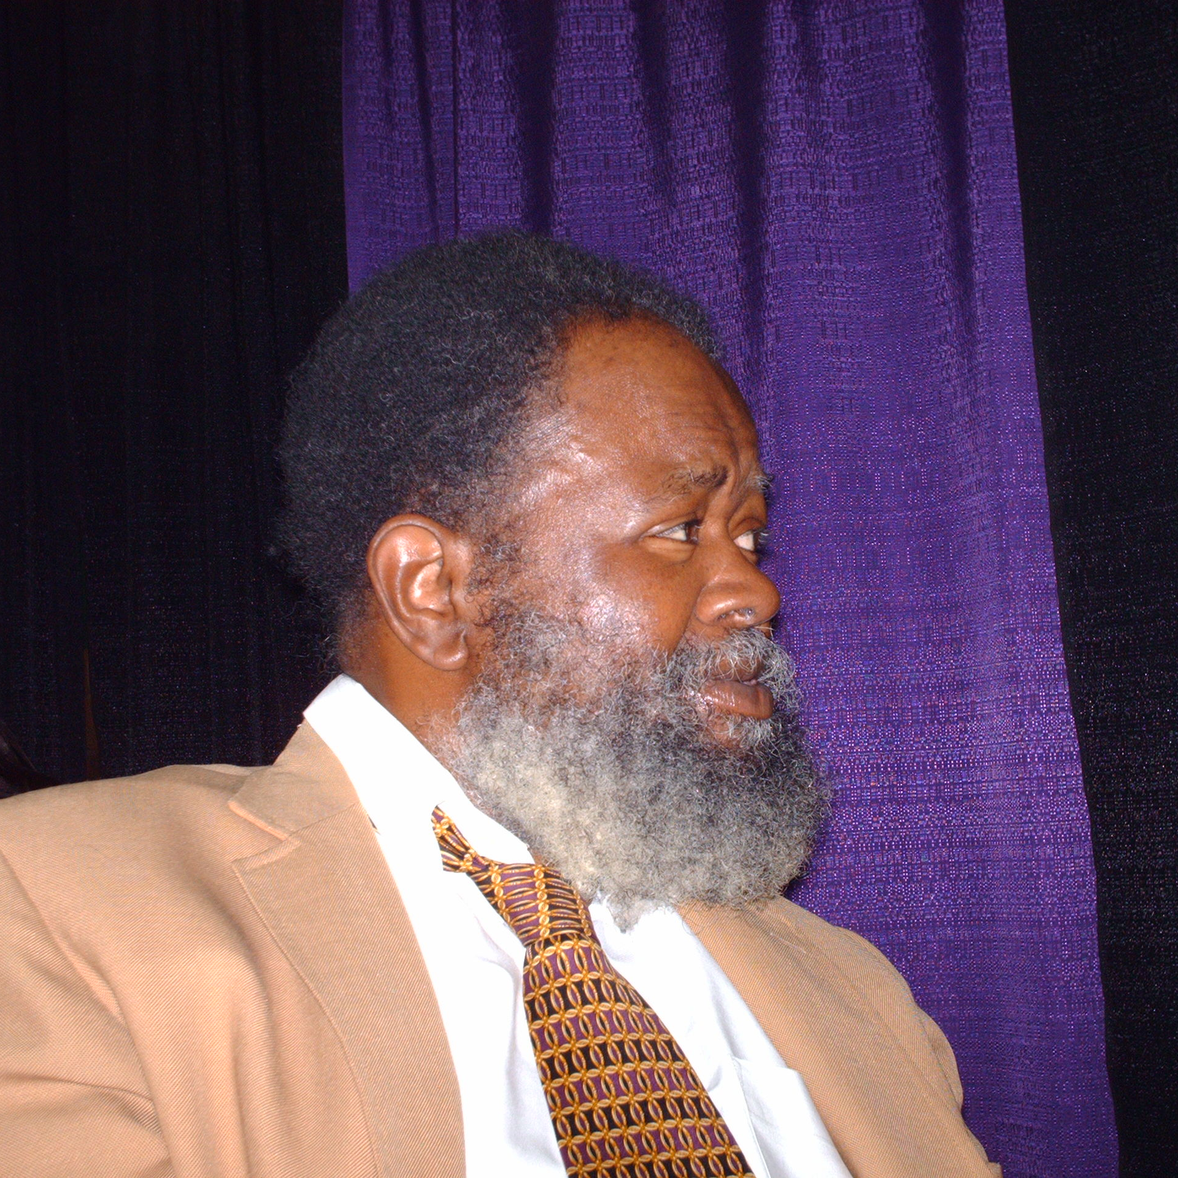
Bobby L. Kaigler Memorial Scholarship
Sponsored By:
Zeta Pi Chapter and Super Soul Saturday Program
The late Bobby L. Kaigler was a graduate of Fort Valley State College, Fort Valley, Georgia where he received a BS in English and Masters in Counseling. Bobby relocated to Erie in 1972 and was employed by the City of Erie for over twenty years as a Compliance Officer and later as the Executive Director of the Erie County Human Relations Commission. Bobby also worked for Stairways and GECAC. Bobby was initiated into Omega Psi Phi Fraternity, Inc. in 1968 through Upsilon Sigma Chapter and was a charter member of Zeta Pi Chapter (Erie, PA) In Erie, Bobby was most known as a mobile DJ and through his volunteer service with WERG/90.5 where he was a volunteer announcer and program director of Super Soul Saturday Program from 1978 until his passing in 2008.

Slide 4
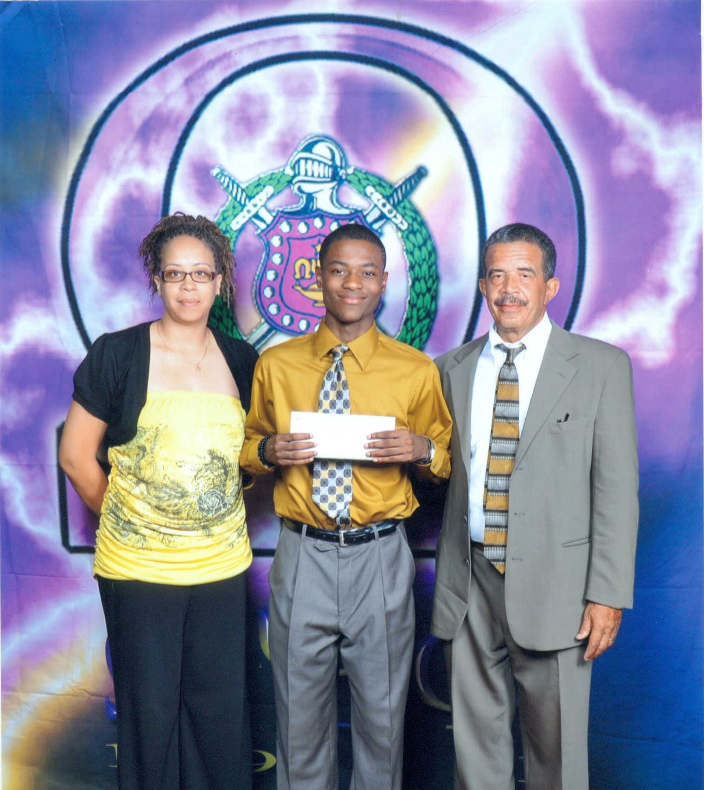
Johnson Family Scholarship
(In Honor of Chevalier and the late Junius Johnson)
Sponsor: Mr. & Mrs. Ted Johnson and the Johnson Family
This scholarship was established by Brother Ted Johnson and the Johnson Family in 2010 in honor of their parents Mrs. Chevalier Johnson and the late Junius Johnson. Applicants must be a currently enrolled minority high school senior and be eligible to attend an accredited four-year college or university. Applicants must be legal U.S. residents, have a minimum 2.75 GPA and reside within the geographic boundaries of Erie County, Pennsylvania.

Slide 5
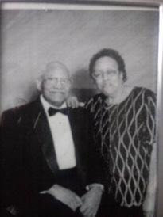
Myers Family Scholarship
(In Honor of Mr. & Mrs. Thomas Myers Sr.)
Sponsor: The Myers and Lofton Families
This scholarship was established by Brother Gregory L. Myers and the Myers Family in 2015 in honor of their parents Mr. & Mrs. Thomas Myers Sr. Applicants must be currently enrolled minority high school senior and be eligible to attend an accredited four-year college or university. Applicants must be legal U.S. Residents, have a minimum 2.75 GPA and reside within the geographic boundaries of Erie County, Pennsylvania.

Slide 6
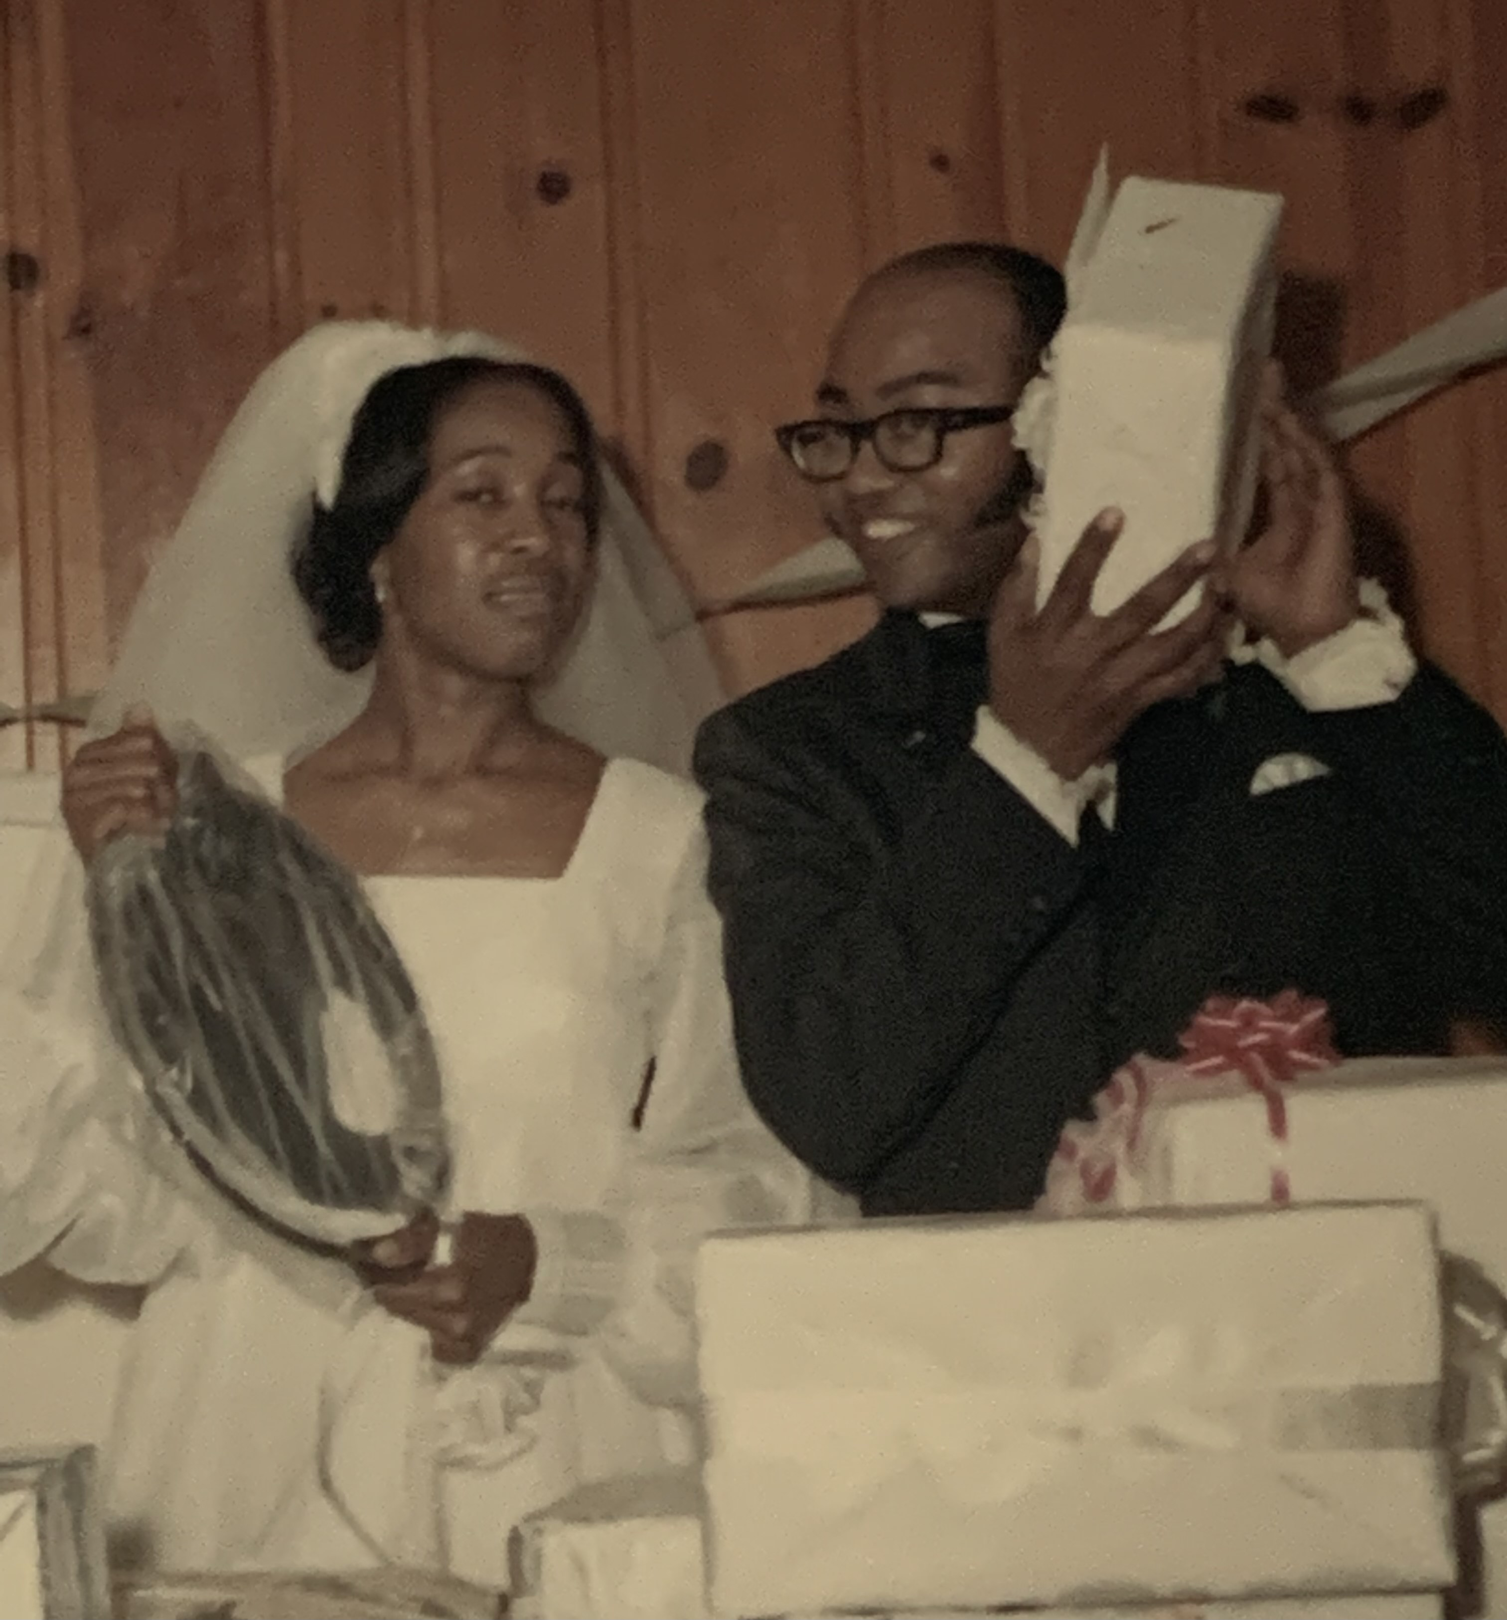
Dr. Vernon D. & Mary L. Dobbs Memorial Scholarship
Sponsor: Dr. Vernon D. Dobbs
This scholarship was established in 2017 by Dr. Vernon D. Dobbs, in memory of his late wife Mrs. Mary L. Dobbs. Dr. Dobbs has additional scholarships established at Mercyhurst University and Gannon University. Applicants must attend a City of Erie High School, have a minimum 3.0 GPA and plan to be attend a historically Black College or University (HBCU) in the Fall of 2022.

Slide 7
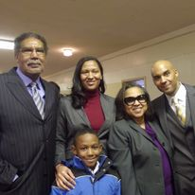
Johnny Johnson Family Vision Scholarship
Sponsor: Mr. & Mrs. Johnny Johnson & Family
This scholarship was established by Brother Johnny Johnson and the Johnson Family in 2021. Brother Johnson is a graduate of Fort Valley State College, an HBCU University in Fort Valley, Georgia. He is a 50 plus year member of Omega Psi Phi Fraternity, Inc. and is a charter member of Zeta Pi Chapter (Erie, PA.) Brother Johnson was an educator in the Erie School District for 35 plus years and was the first Black High School Basketball Coach in the City of Erie. Applicants must be a currently enrolled minority high school senior and be eligible to attend an accredited four-year college or university in the fall of 2022. Applicants must be legal U.S. Residents, have a minimum 2.75 GPA and reside within the geographic boundaries of Erie County, Pennsylvania.

Slide 8

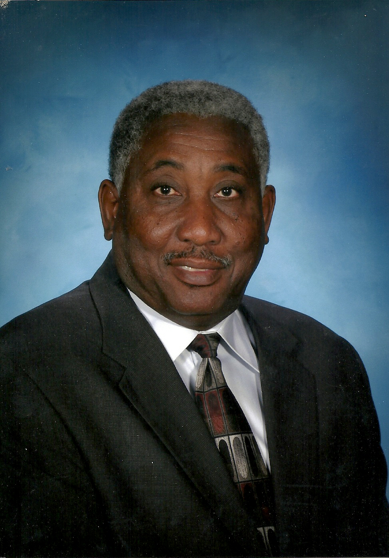
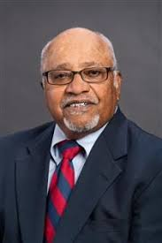
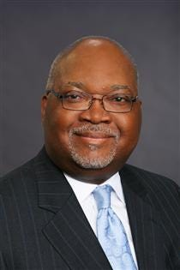
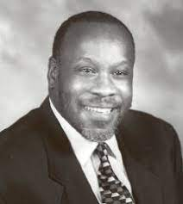
Bridge Builder Scholarships
Sponsor: Greater Erie Community Development Corporation
My Brother's Keeper and Omega Psi Phi Fraternity, Inc. through a grant from the Greater Erie Economic Development Corporation established the Bridge Builder Scholarships in 2019. (4) $ 1,000.00 scholarships will be awarded to minority high school graduating seniors in memory of (4) trailblazing African American Men, Mr. R. Benjamin Wiley, Mr. John Drew; Mr. Ronald A. Steele and Mr. Johnny Harris.

Slide 9
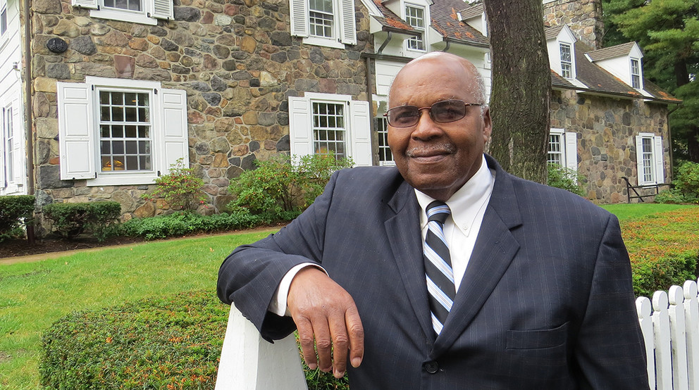
Eva Tucker Jr. Memorial Scholarship
Sponsored By: St. James AME Church, The Tucker Family, Erie Public Schools
along with donations from My Brother's Keepers of Erie
This scholarship have been established by the Men and Women of St. James AME Church and other Caring Men and Women of the Erie Community. The My Brother's Keeper Initiative established by President Obama in 2014 speaks to African American Men providing support to African American Youth to help them think more broadly about their future. In Genesis 4:9, God asks Cain the question, where is your Brother Abel. Cain responded, “Am I My Brother's Keeper.” The My Brother's Keepers of Erie, Pennsylvania responded to the charge, “Am I My Brother's Keeper, Yes I Am.” In 2020, this scholarship was renamed the Eva Tucker Jr. Memorial Scholarship in honor of former Educator and longtime Erie School Board Director. This scholarship is available to a 2022 male or female minority high school graduate.

Slide 10
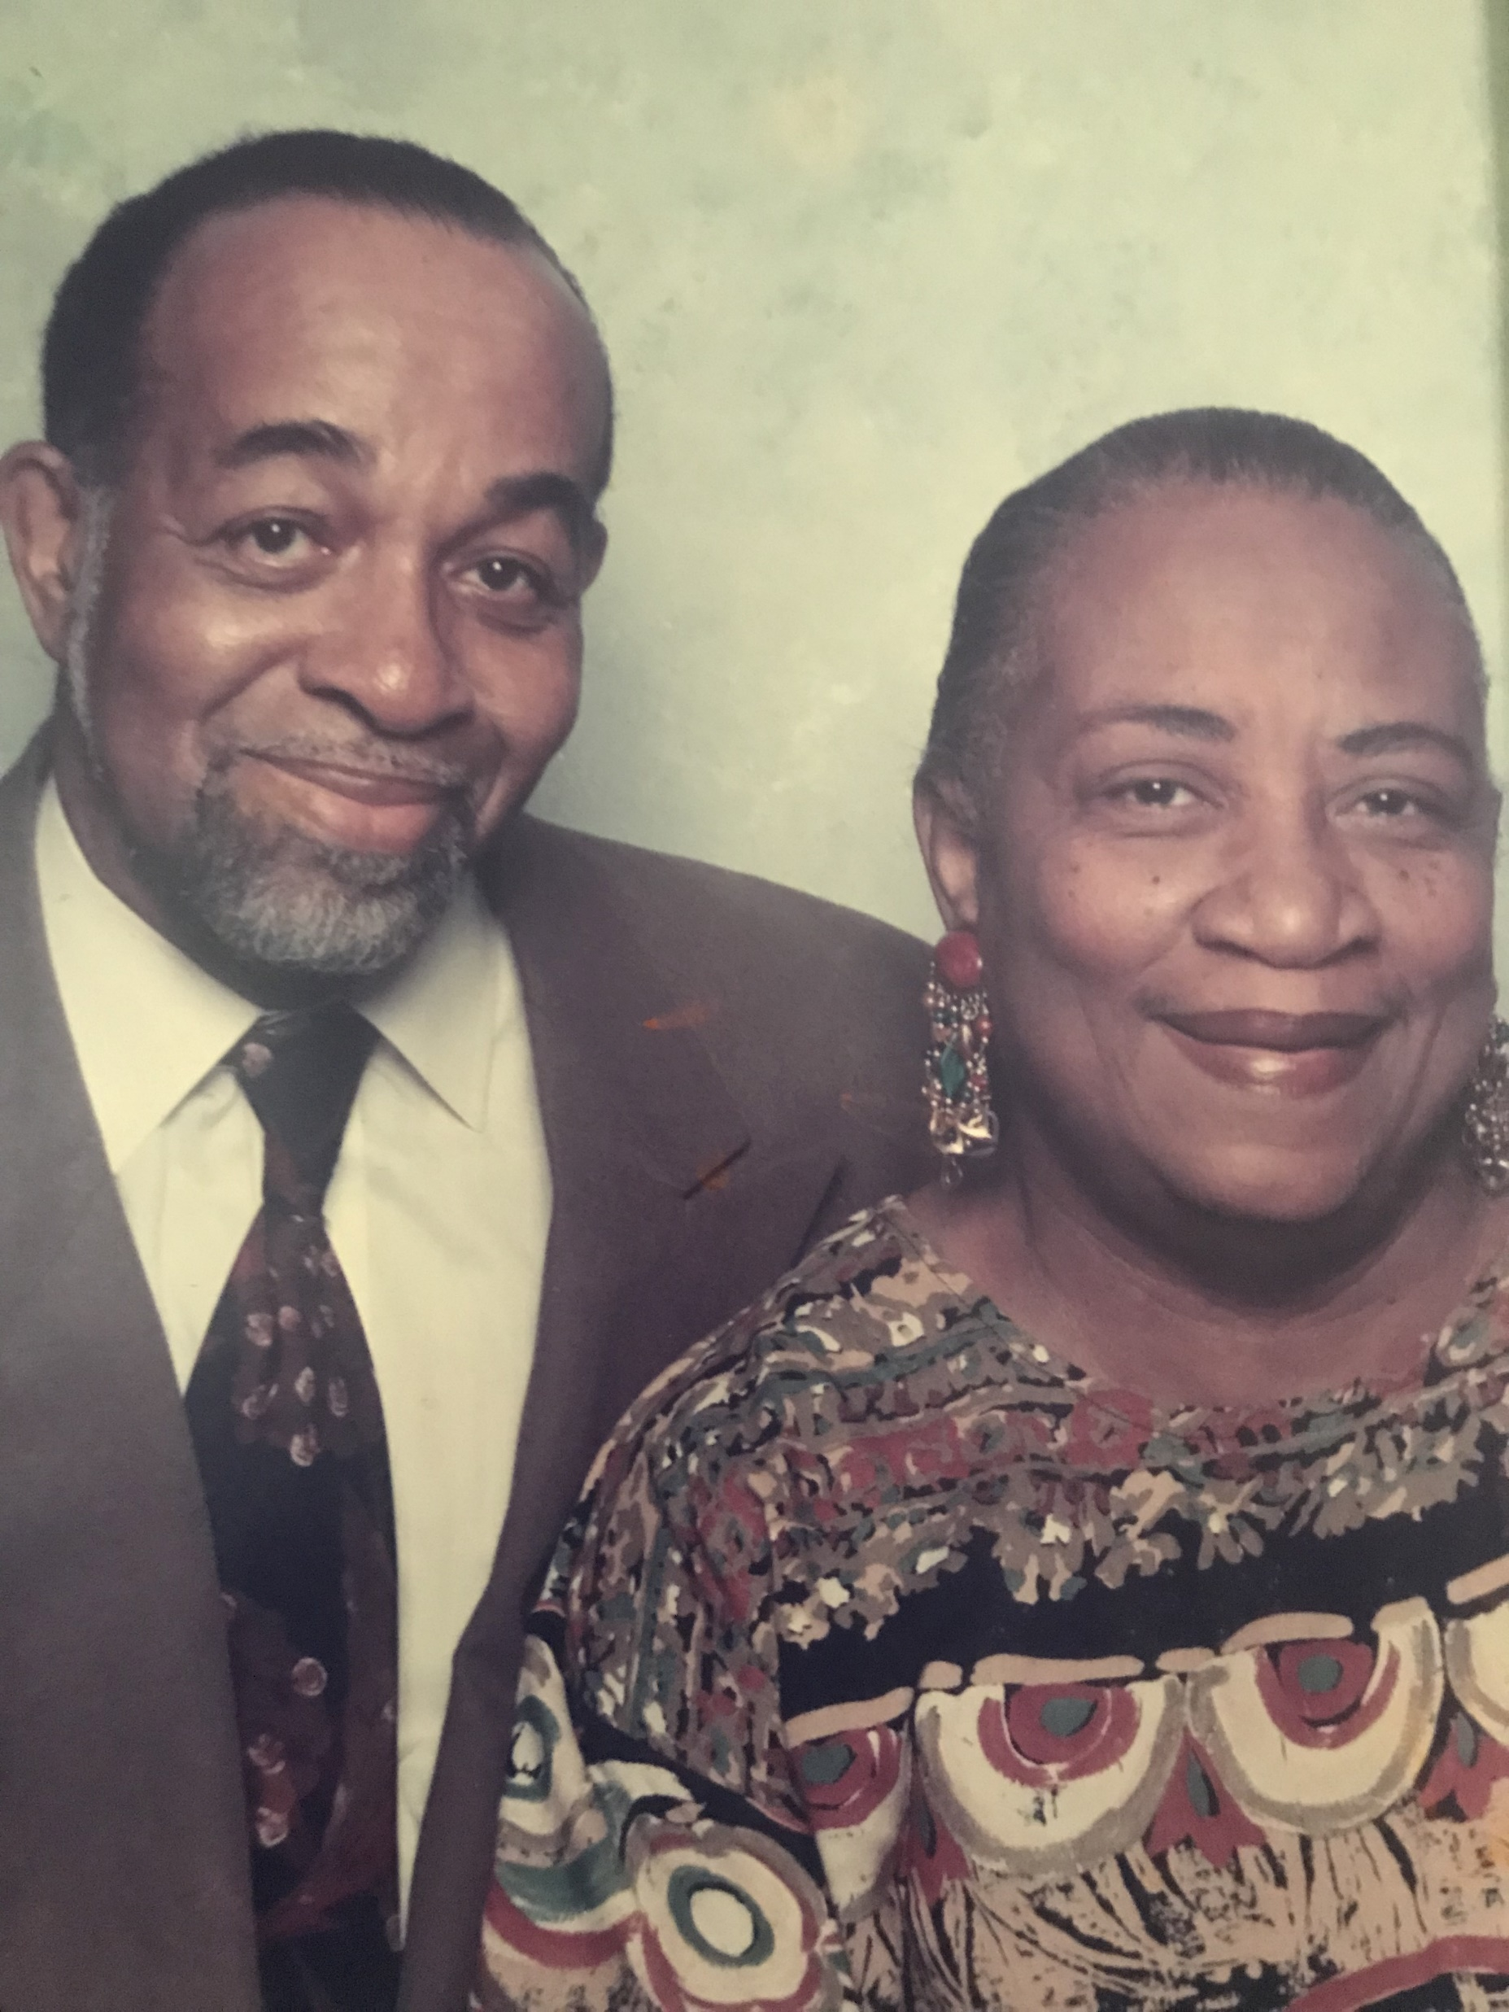
Mr. & Mrs. Howard R. and Mildred Smith Horton Scholarship
Sponsor: The Horton Family & Friends
This scholarship was established in 2018 by the Horton Family to honor their parents the late Howard R. Horton Sr. and Mildred Smith Horton. Mr. & Mrs. Horton were community activists, both serving as President of the local branch of the NAACP. Mr. Horton was a member of the Bay City Lodge #68 and served on the Laborers 603 Council. He was an active member of St. James AME Church where he served on the Trustee Board and laid the cornerstone at the church current location, 236 East 11th Street. Mrs. Horton retired from Erie Technological Products after 32 years of service. She served as a Cub Scout Den Mother in the early sixties, a member of the Erie City Zoning Board, a Parent Rep for little gridders football and little league baseball. She served on the Board of Trustees for many years at St. James AME Church.

Slide 11
Mr. & Mrs. Horton served as Dorm Parents for the Gannon University Upward Bound Program for more than 20 years and were Foster Parents with the Erie County Office of Children and Youth. This is the second scholarship honoring Mr. Horton & Mrs. Horton. The Wiley Horton Scholarship was established at Gannon University in 2005 by the African American Alumni of Gannon University that honors the legacy of Mr. & Mrs. Howard Horton and the late R. Benjamin Wiley.

Slide 12
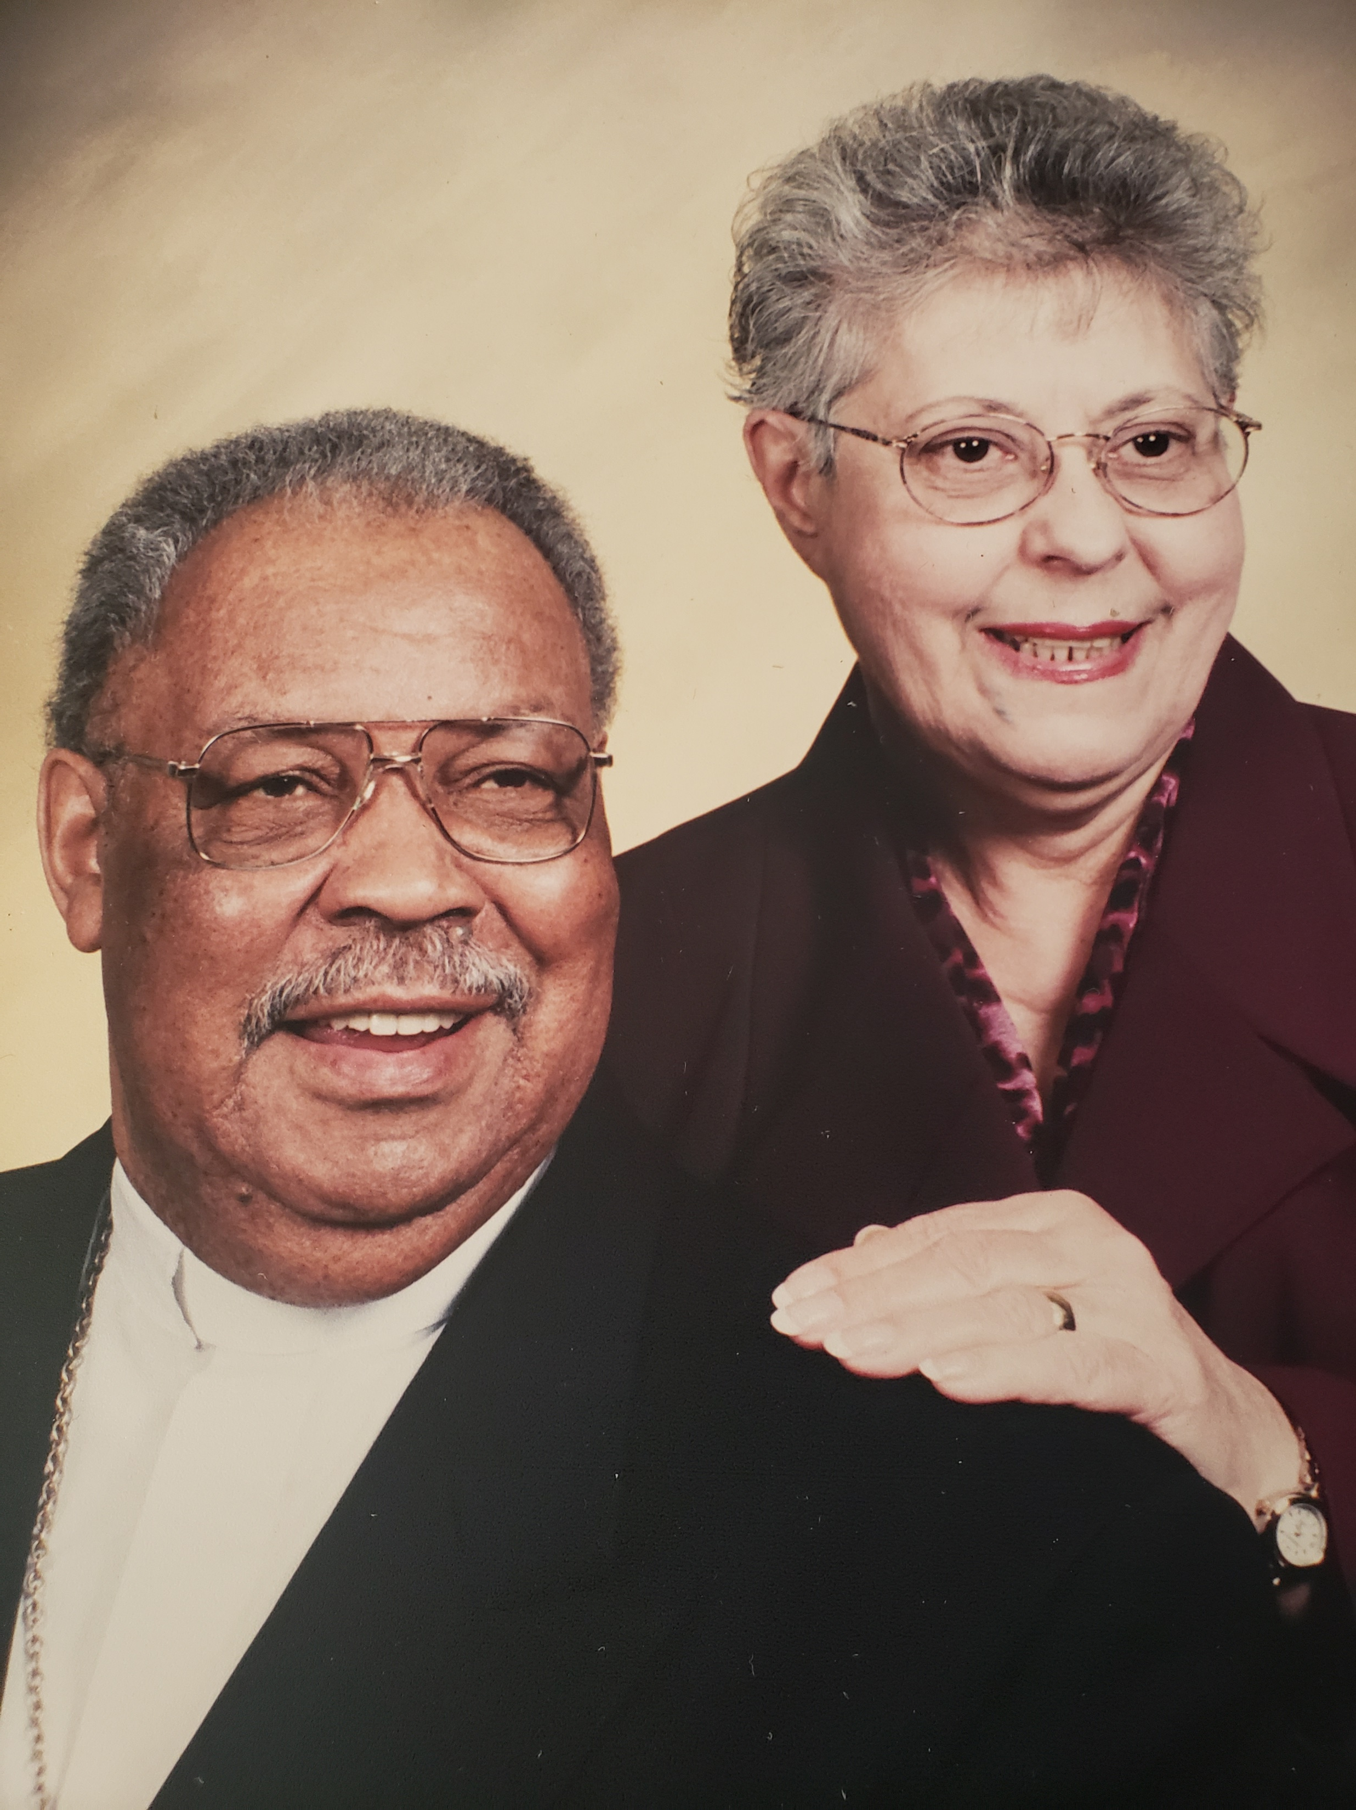
Rev. Jon S. and Raffalda Goshay Scholarship
Sponsored by the Goshay Family and St. James AME Church
The Rev. Jon S. & Mrs. Raffalda Scholarship was established in 2022 by the Goshay family and St. James AME Church. Reverend Jon Stuart Goshay has lived a multifaceted life with many a twist and turns. Born in Waynesburg, Ohio and has called Canton Ohio his hometown for the past 50+ years. His educational undergraduate and graduate background include Wilberforce University (Wilberforce OH), the University of Akron (Akron OH) and Westminster College (New Wilmington PA). He is also a member of Alpha Phi Alpha fraternity Inc.

Slide 13
Raffalda Goshay, beloved wife of Rev. Jon Goshay was an incredible wife and mother. Born in Canton, Ohio, Raffalda loved the Lord and gave her talents and gifts back to the church’s she served as First Lady. She served as an administrative assistant in each of her husband’s charges. Raffalda was an Area 5 Chairwoman of the Women’s Missionary Society of the Pittsburgh Conference, and an active member of the Ministers Spouses.
Rev. Goshay and his wife Raffalda were married for 55 years before her passing. They have six children, 12 grandchildren and 14 great grandchildren. Applicants must be eligible to attend an accredited four-year college or university, have a minimum 2.75 GPA (for high school seniors and reside within the geographic boundaries of Erie County, Pennsylvania.)
During his ministry, he served AME congregations for 6 years at Greater Morris Chapel (Farrell PA) where he purchased a new parsonage and remodeled the church’s dining room, 12 years at St. James (Erie PA) where he purchased a new parsonage and built a new church, 6 years at Brown Chapel (Pittsburgh PA), 10 years at Saint Andrews (Youngstown OH) where he built a new church and his final year in ministry was at Quinn Memorial (Steubenville OH).
He served in the United States Military as a paratrooper in the famed 82nd Airborne Division and as a Green Beret in the elite 10th Special Forces Group. He was a teacher in the Akron public schools, and an administrator in the Title I program in the Canton city schools. He was in charge of the Prevocational Department of the Erie OIC, and an Erie County Affirmative Action Officer. While in Erie he also served as president of the Erie Branch NAACP, which he is a lifetime member and was president of IMAGE.

Slide 14
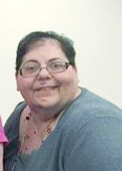
Kathy M. Goshay Memorial Scholarship
Sponsored by the Goshay Family
The Kathy Goshay Memorial Scholarship was established by the Goshay Family in 2022. Kathy M. Goshay was born in Canton, Ohio, she was a dedicated Licensed Practical Nurse for over 30 years, spending most of those years in service to others at Pleasant Ridge Manor (Girard, PA). Her choice in career helped define who she was as a person; she had a calling to help others, and truly lived her life with purpose. Kathy was an avid reader and loved a good novel. She was also a big Philadelphia Eagles fan and was the perfect example of what it means to be a true daughter, sister and friend. Applicants must be eligible to attend an accredited four-year college or university, have a minimum 2.75 GPA (for high school seniors) and reside
within the geographical boundaries of Erie, County, Pennsylvania.

Slide 15
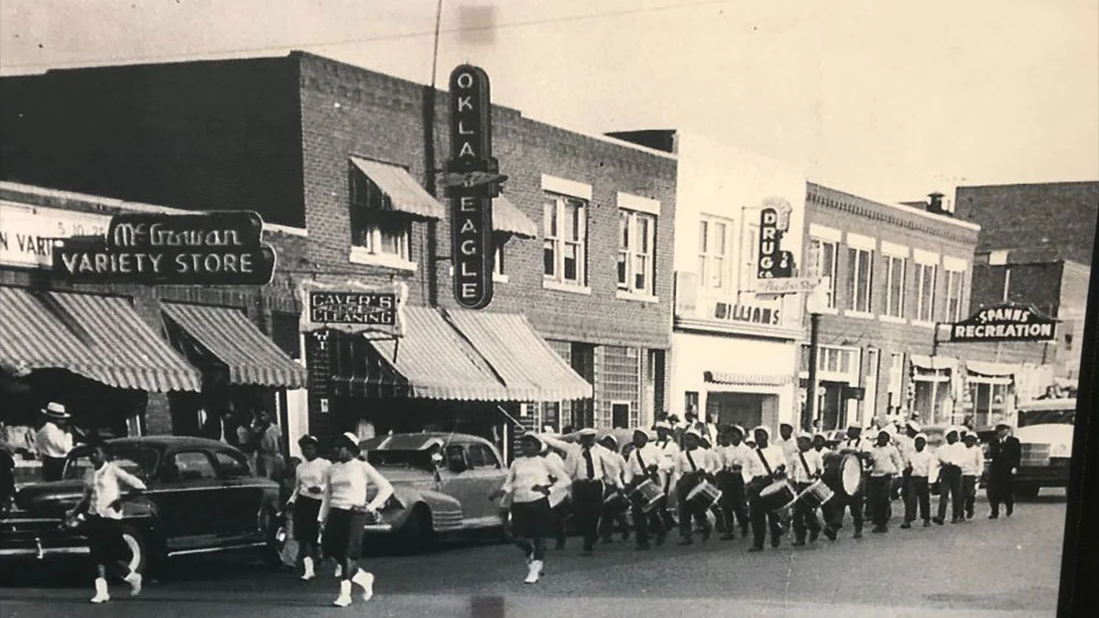
A.J. Smitherman
Black Wall Street Commitment To Excellence Award
This scholarship was established in 2021 by Al Smitherman the Great Grandson of Civil Rights Leader and News Paper Publicist, A.J. Smitherman. This award is available to a 2022 Minority High School Graduating Senior. Eligible applicants were to write an essay about Black Wall Street.

Slide 16

Uplift Foundation Scholarship
This scholarship was created by the officers of Uplift Foundation in 2022 to support scholarship opportunities for African American and Minority High School Graduating Seniors and to continue the Cardinal Principle of Uplift for others to achieve their goals.

Slide 17
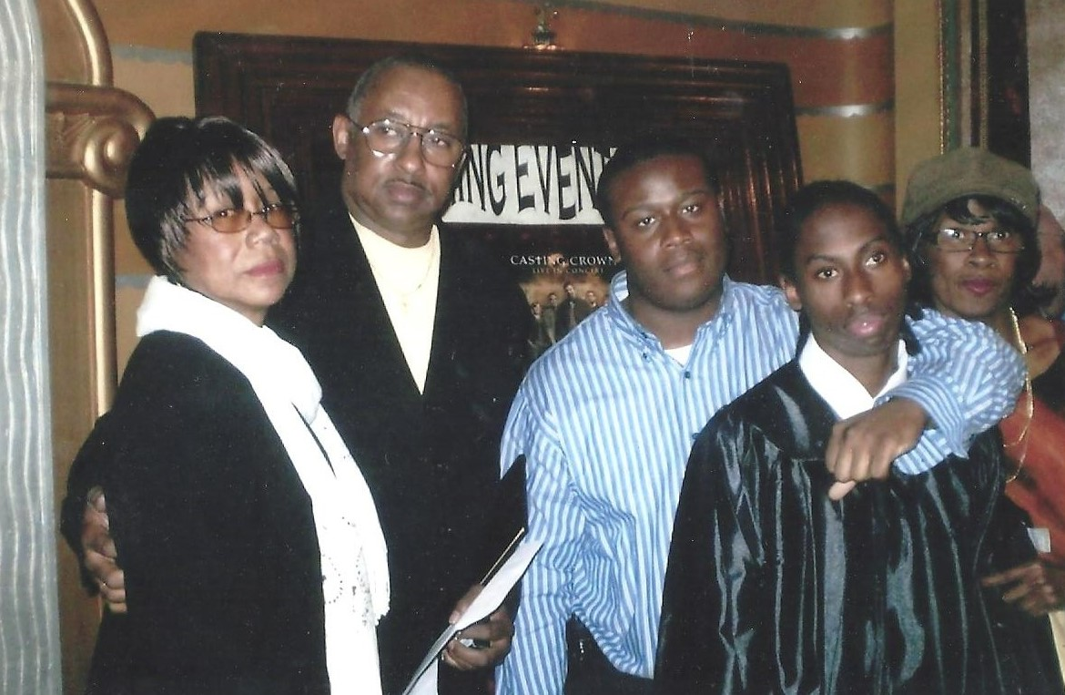
Smith Family Scholarship
Sponsor: Nijel N. Smith,
2006 NWPA Collegiate Academy Graduate
This Scholarship is sponsored by Nijel N. Smith a 2006 graduate of NWPA Collegiate Academy, 2010 Graduate of Gannon University and a January 2017 MBA Graduate of the University of Maryland. Nijel is awarding this scholarship in honor of his Brother, Jordan L. Smith. This scholarship is available to a 2022 African American High School Graduate of NWPA Collegiate Academy. Nijel also hopes, that other young men and women including the recipient of this award will pay forward personal blessings to future young men and women of Erie.

Slide 18
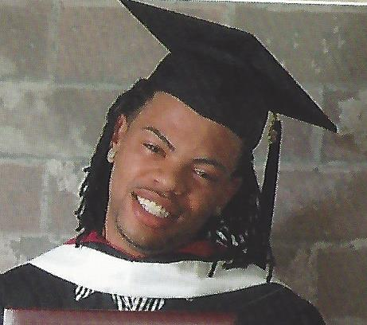
Mitchell Jones Jr. Scholarship
Sponsor: Mitchell Jones Sr.
This scholarship was established by Mitchell Jones Sr., in 2019 in memory of his late son Mitchell Jones Jr. Applicants must have a minimum GPA of 3.0 and plan to attend an accredited college or university in the fall of 2022.

Slide 19
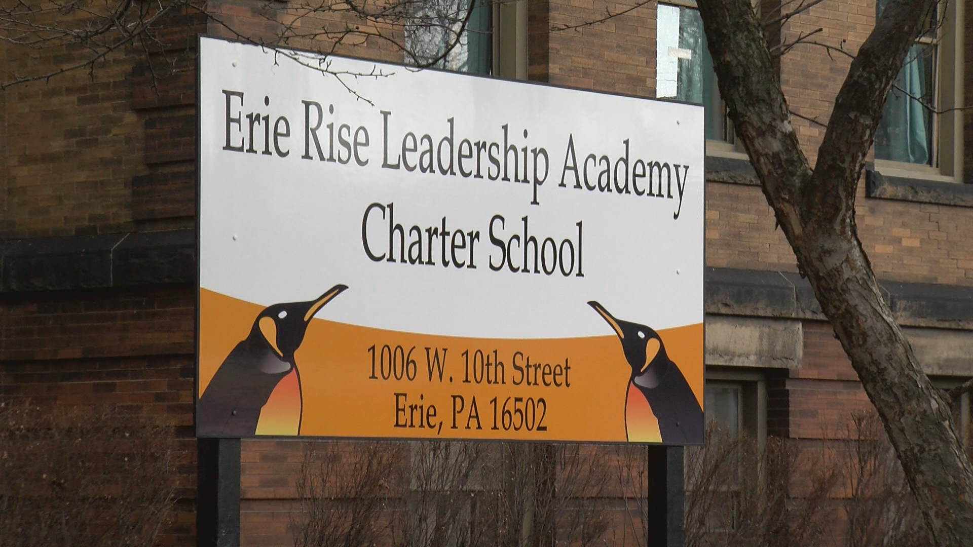
Erie Rise Leadership Academy Charter School Scholarship
Sponsor: Erie Rise RFO and Erie Rise Board of Trustees
Two annual scholarships were established in 2020 by the Erie Rise RFO and Board of Trustees to support the (2016) graduating class of Erie Rise Leadership Academy Charter School with their secondary education pursuits. Applicants must have a minimum 2.75 GPA, be a graduate of Erie Rise Leadership Academy Charter School and plan to attend an accredited college or university in the fall of 2022.

Slide 20
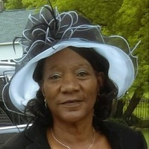
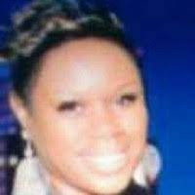
Leach-Ruff Family Scholarship
Sponsor: Handled with Care Childcare
This scholarship was established by Nadine Leach in 2020 in memory of the Reverend Charles J. Ruff and Mrs. Nealy Leach Ruff. Applicants must have a minimum GPA of 2.75 and plan to attend an accredited college or university in the fall of 2022.

Slide 21
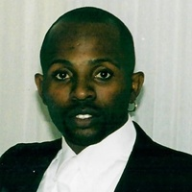
THE ERIC KENNETH CLAYTON MEMORIAL SCHOLARSHIP
Sponsored by the East High School Class of 1988
The Eric Kenneth Clayton Memorial Scholarship was established in 2021. The (EKCMS) scholarship was established to pay tribute and honor the memory of Eric Kenneth Clayton, our beloved friend while creating an opportunity for others. Eric was the son of Luke and Delois Clayton, he was a 1988 graduate of East High School. Eric was captain of the East High Football team and played baseball. He was the father of three (3) children. Eric passed away on February 7, 2020. This scholarship is in honor of our Father, Brother, Uncle and Friend. We love and miss you Eric, you are forever in our hearts. Eligible applicants must be a 2022 graduate of an Erie County High School, have a 2.5 GPA and attend an accredited college or university in the fall of 2022.

Slide 22
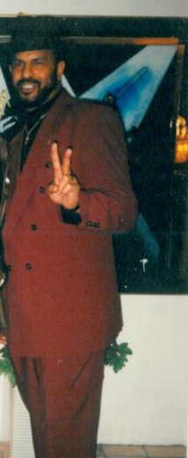
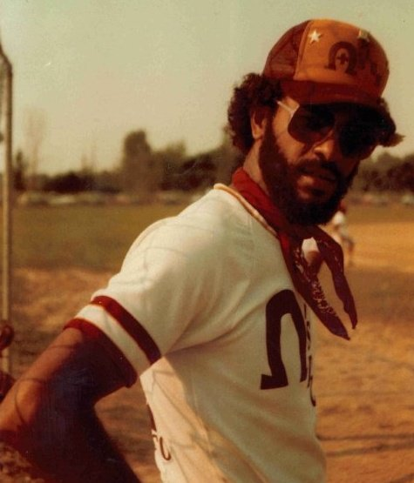
Robert M. Barney Memorial Scholarship
Sponsor: The Barney Family & Friends
This scholarship was established by the Family and Friends of Robert M. Barney in 2021 to honor the legacy of Robert Mitchell Barney. Brother Barney received his Undergraduate and Master Degree from Gannon University. He was the first of (4) family members who are members of Omega Psi Phi Fraternity, Inc. (Zeta Pi Chapter), an Administrator of the City of Erie Employment and Training Department, Co-Founder of the Quality of Life Learning Center and past Director of the United Softball League. Applicants for this scholarship must have a minimum GPA of 2.75 and plan to attend an accredited college or university in the fall of 2022.

Slide 23
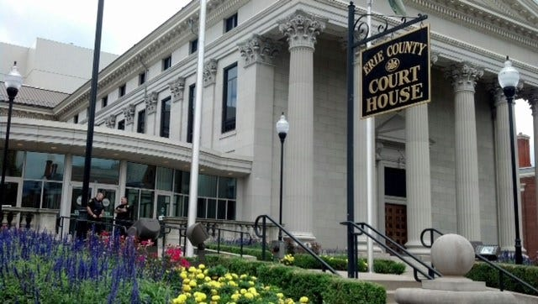
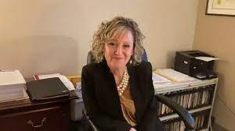
Super Soul Saturday Memorial Scholarship
Sponsor: The Erie County District Attorney's Office
In 2021 Super Soul Saturday Program in partnership with District Attorney Jack Daneri and the Erie County District Attorney's office established this scholarship to honor the deceased volunteers who dedicated their weekends and holidays as broadcasters with Super Soul Saturday on 90.5/WERG. Eligible applicants must be a 2022 Erie County High School graduate with a GPA of 2.75 or higher and plans to attend an accredited college or university in the fall of 2022.

Slide 24
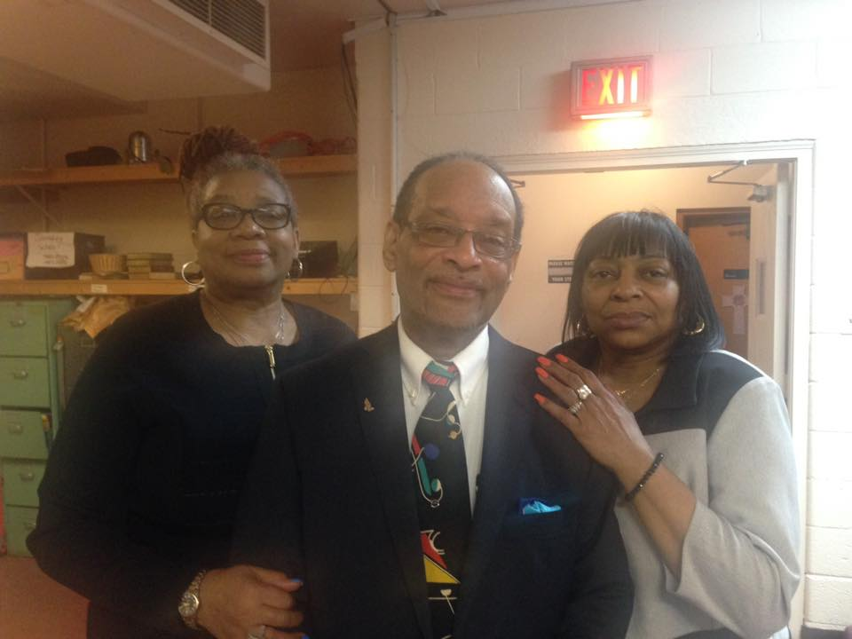
McConnell Family Scholarship
Sponsored By:
Super Soul Saturday Timmie Mack Morning Show Donors
This scholarship was established in 2021 by Super Soul Saturday Program and the listeners of the Timmie Mack Morning Show. This scholarship honors the McConnell Family as one of the first Black families to settle in Erie County. Eligible applicants must be a 2022 Erie County High School graduate with a GPA of 2.75 or higher and plans to attend an accredited college or university in the fall of 2022.

Slide 25
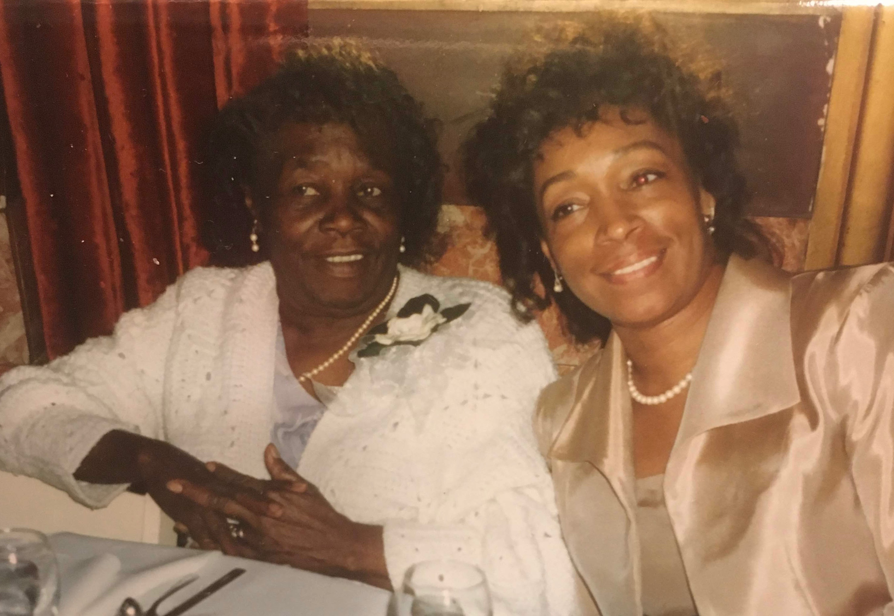
“How simple a thing it seems to me that we know ourselves as we are we must know our Mother’s name”.
- Alice Walker
Giving Tree Scholarship
This scholarship was established in 2022 by Bobbie L. James Hoye (1994 graduate from Villa Maria Academy), Erik W. James (1991 graduate from Cathedral Preparatory High School), and Lisa M. James Pearson (1988 graduate from Villa Maria Academy), in honor of their father, Edward (“Bubba”) James Jr. Mr. James was born and raised in Erie, PA. He graduated from Academy High School and attended Penn State Behrend. Mr. James college education was interrupted when he was drafted into the United States Army, where he served his country honorably. Upon returning to Erie, Mr. James began working at General Electric for the next 38 years, volunteered as a wrestling coach at the J.F.K. Center for 6 years, was a member of the Unknowns softball team, and an active member at Second Baptist Church. This scholarship is available to applicants who are currently enrolled as a high school senior or a GED recipient. Applicants must be eligible to attend an accredited four-year college or university, have a minimum 2.5 GPA (for high school seniors) and reside within the geographic boundaries of Erie County, Pennsylvania.

Slide 26
Preference will be given to first generation students. (For purposes of this scholarship first generation is defined as a student whose parents or legal guardians have not graduated from an institution of higher education with a four (4) year degree) and students who reside in the Harbor Homes.

Slide 27
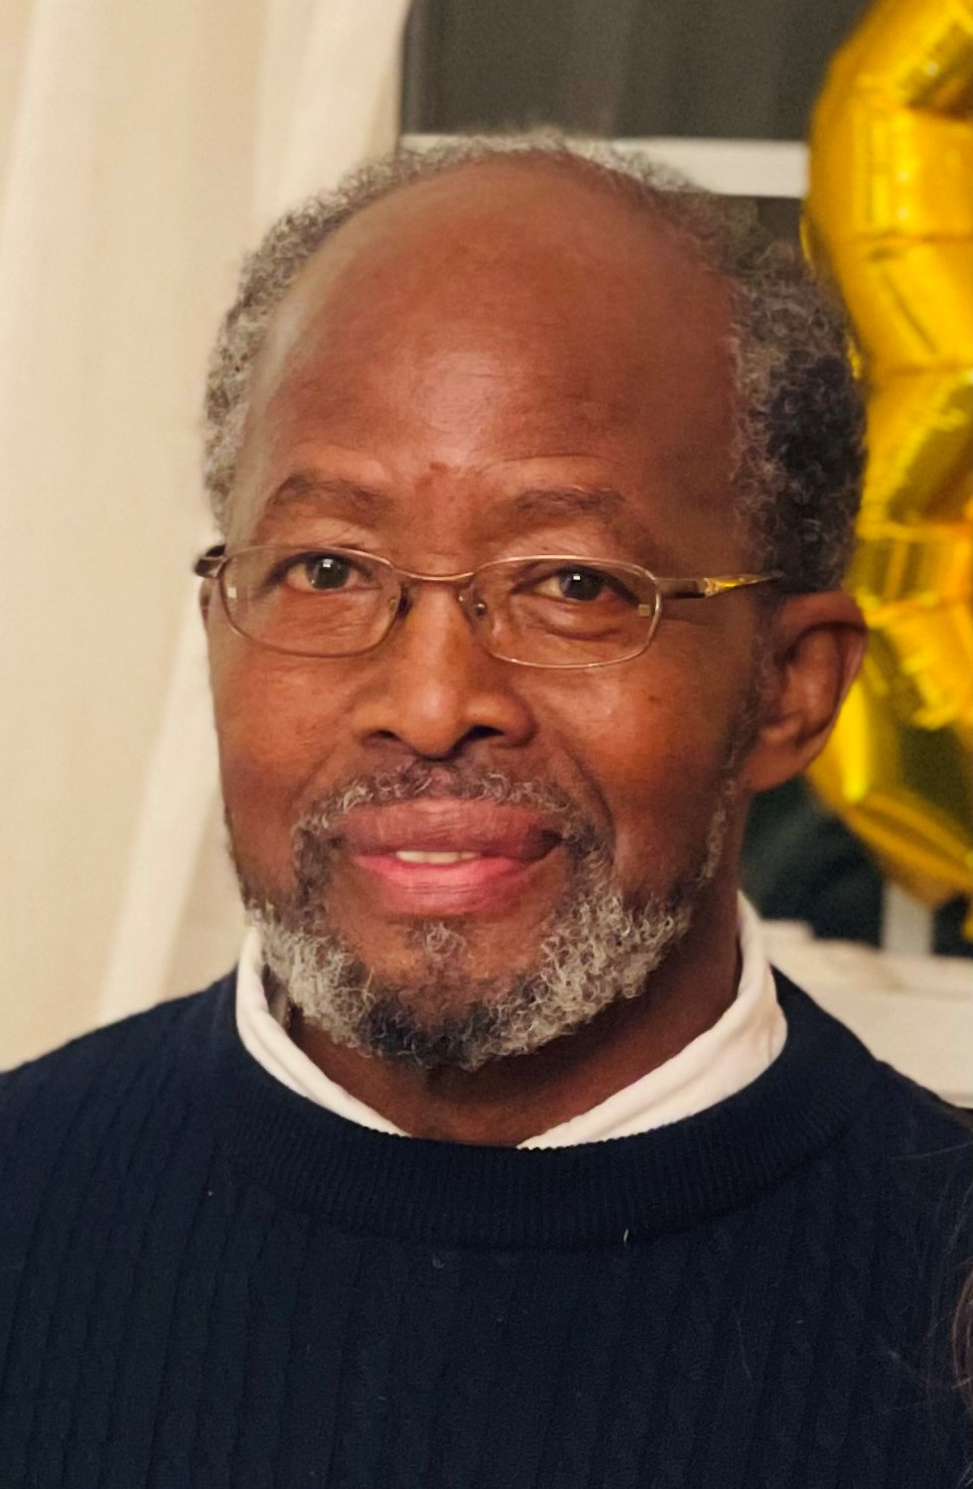
James Family Scholarship
This scholarship was established in 2022 by Bobbie L. James Hoye (1994 graduate from Villa Maria Academy), Erik W. James (1991 graduate from Cathedral Preparatory High School), and Lisa M. James Pearson (1988 graduate from Villa Maria Academy), in honor of their father, Edward (“Bubba”) James Jr. Mr. James was born and raised in Erie, PA. He graduated from Academy High School and attended Penn State Behrend. Mr. James college education was interrupted when he was drafted into the United States Army, where he served his country honorably. Upon returning to Erie, Mr. James began working at General Electric for the next 38 years, volunteered as a wrestling coach at the J.F.K. Center for 6 years, was a member of the Unknowns softball team, and an active member at Second Baptist Church. This scholarship is available to applicants who are currently enrolled as a high school senior or a GED recipient. Applicants must be eligible to attend an accredited four-year college or university, have a minimum 2.5 GPA (for high school seniors) and reside within the geographic boundaries of Erie County, Pennsylvania.

Slide 29
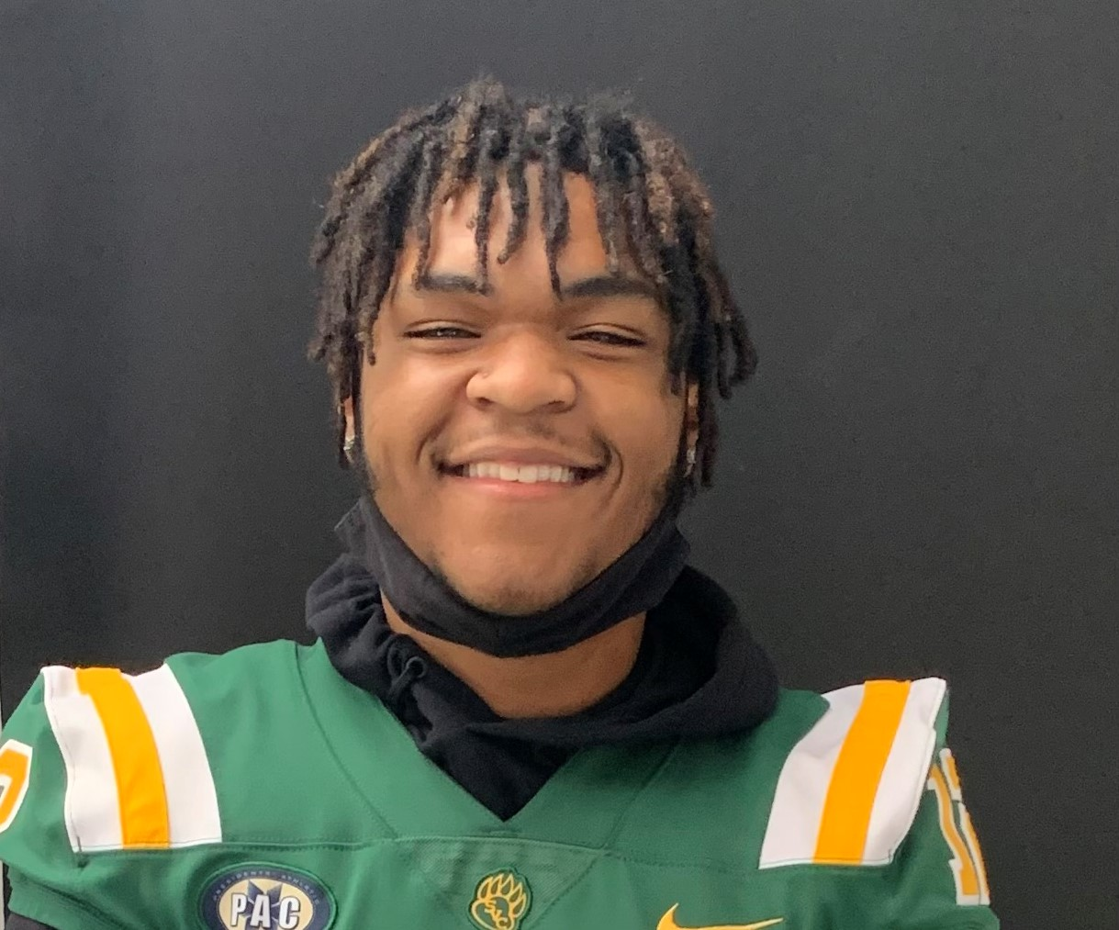
2022 My Brother's Keeper Scholarship/Omega Psi Phi Recipients Bios
Gabriel R. Alexander
Is the son of Denise Alexander. Gabriel is a 2022 graduate of Erie High School who will be attending Saint Vincent College as an Accounting Major this Fall. Gabriel is a 3-year varsity starter, was able to manage his time to be a student athlete. He is described as never backing down from a big project, having excellent time management skills, balancing school and being a part of two varsity teams, and a part time job at Firehouse Subs. Gabriel graduated with a 3.05 GPA.

Slide 30
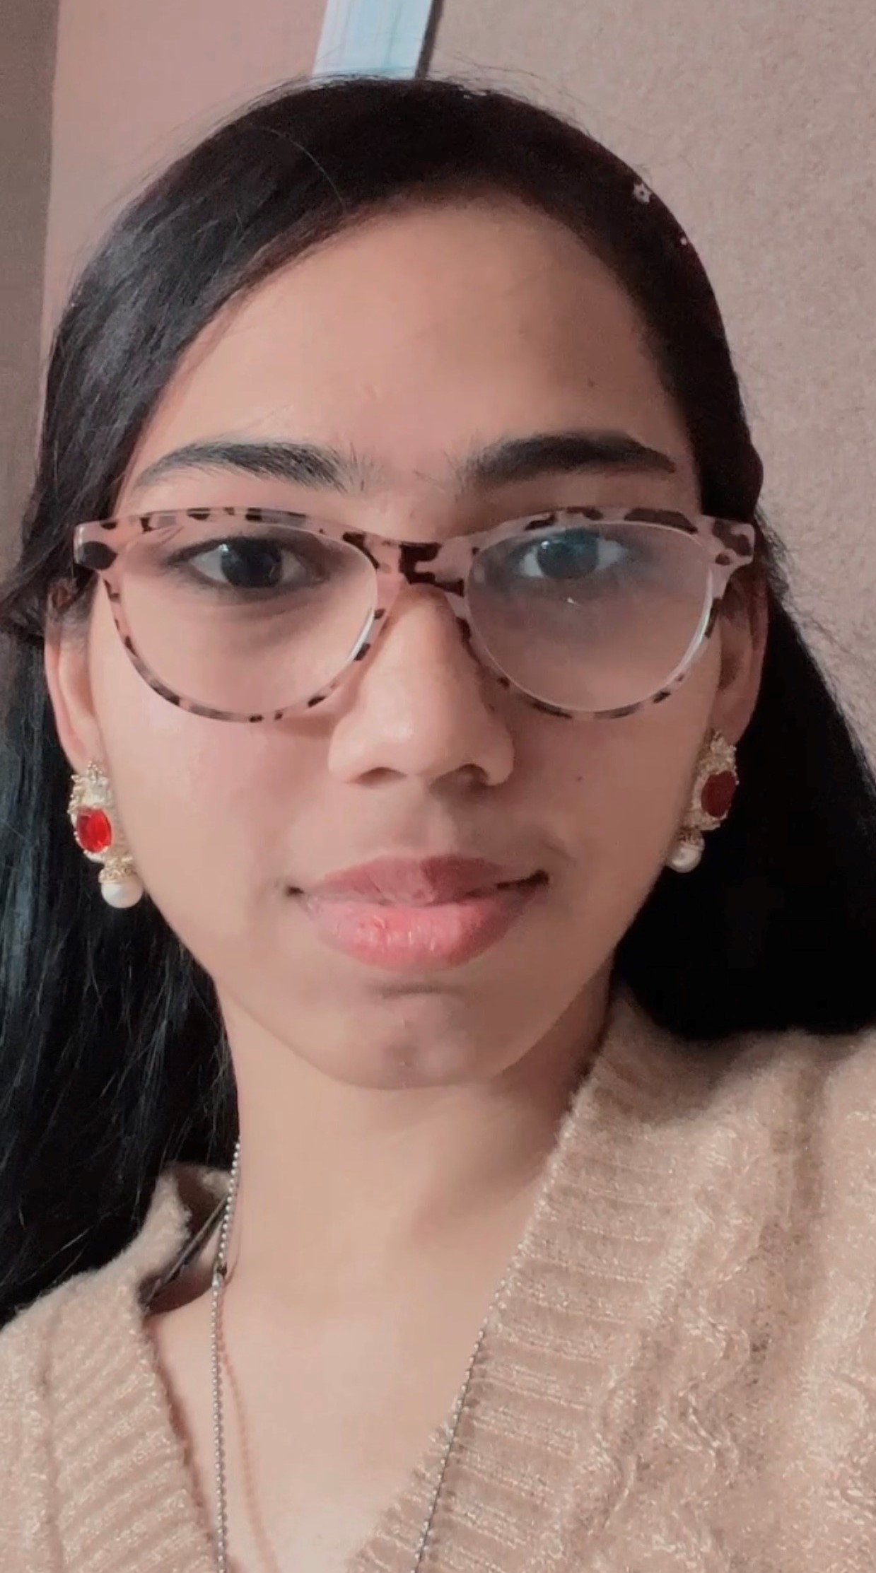
Nabia Attique
Is a 2022 graduate of Erie High School who will be Gannon University in the fall, majoring in Nursing. Nabia is a member of the National Honor Society and participated in the Book Club. She has worked for Aspire Home Care as a caregiver, Plastic Group as an operator and Sugar Bowl Bakery as an operator. She is described as a mature and sensible young lady. Despite obstacles and setbacks as an independent student she has not allowed those things to stop her from reaching her goals. Nabia has been living on her own, paying her bills, working and still excelling in school. She stays positive and does whatever it takes to solve any of her personal or academic issues. Nabia has a GPA of 3.72.

Slide 31
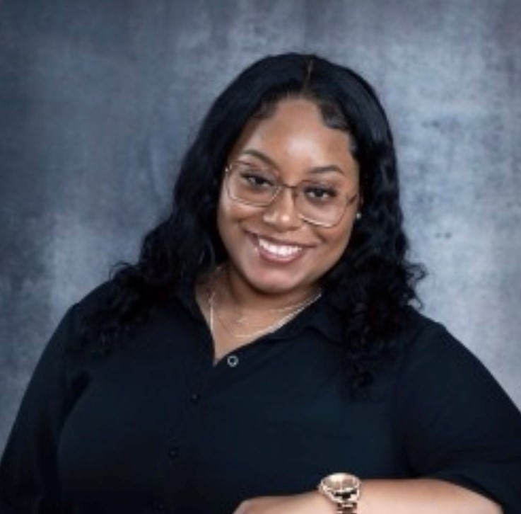
Samantha Baker
Is the daughter of Parris J. Baker and Brenda Abreu-Baker. Samantha is a 2022 graduate of Northwest Pennsylvania Collegiate Academy who will be attending Gannon University this fall majoring in Nursing. Samantha is a 17-year-old female of Puerto Rican and African American heritage. She realizes the necessity to add her voice to protest and change. She wants to be an advocate for those who cannot or will not speak human and civil rights. Samantha believes that education is the pathway out of poverty, community violence and the way we can resolve world conflicts. Samantha is described as a young woman of great character, intelligence and talent. She has displayed the leadership and work ethic that every coach hopes for from his top student athletes. Her career goal is to work in the healthcare or medical field with children, focused on prevention and early intervention of childhood disease and trauma. Samantha has a GPA of 3.54.

Slide 32
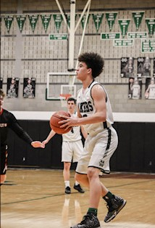
Trey Battle
Is the son of Mr. & Mrs. Gerald Battle. Trey is a 2022 graduate of Mercyhurst Prep High School who will be attending Penn State Allegheny this fall majoring in Business Administration. Trey is a basketball athlete who love being with his family who love and support him no matter how bad or good it is. His favorite hobby is playing video games and hanging with his teammates. In life he has often been told, he would never be successful, and his goal is to not only prove them wrong, but to help his family and make them proud. His grand-parents always encouraged him to work hard and be a positive example for his family and his community.

Slide 33

Shaan W. Bolden
Is the son of Shaana Carter. Shaan is a 2022 graduate of Erie High School who will be attending Mercyhurst University this fall majoring in Physical Therapy. Shaan has a passion for helping others and wants to help people get there bodies back to where they once were. He is described as a wonderful, outgoing young man, someone who is eager to learn. He was a member of the JV and Varsity basketball team. He received the Good Kid of the Week Award in middle school and the Student of the Week Award in High School. Shaan participated in the Upward Bound Program, UPMC Health Scholars Program, and Erie High Athletics. Shaan has a GPA of 2.81

Slide 34
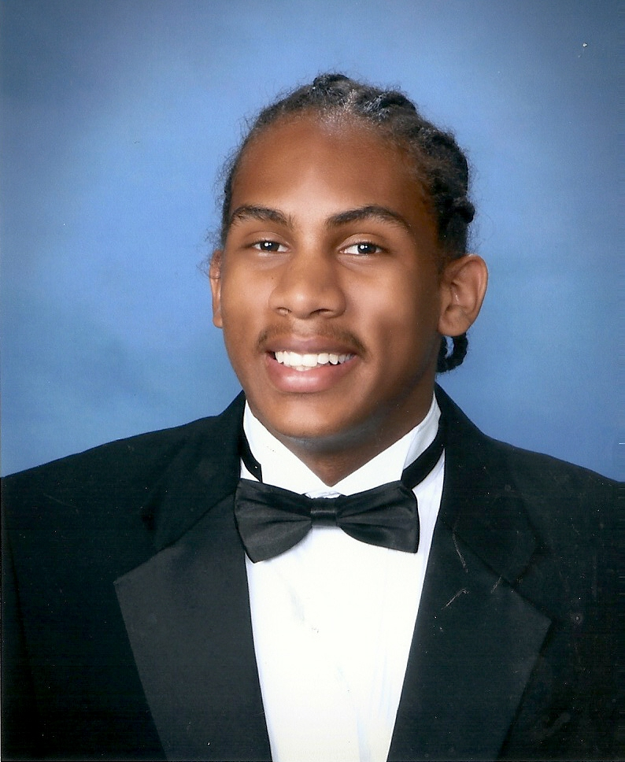
Aronde Marquell Bridgett
Is the son of Andre and Sarah Bridgett. Aronde is a 2022 graduate of Mercyhurst Prep High School and will be attending Thiel College majoring in Criminal Justice this fall. Aronde has been described as a team player, a leader and great teammate. He excelled in two sports at the varsity level at Mercyhurst Prep, Football for (4) years; Basketball for (4) years. In his senior year he also participated in track and field. He is a member of the Erie Ice AAU Basketball team. Aronde volunteers with Spoon’s Summer Youth Basketball League, MPS Youth Football camp and a volunteer at Erie Abyss haunted house.

Slide 35
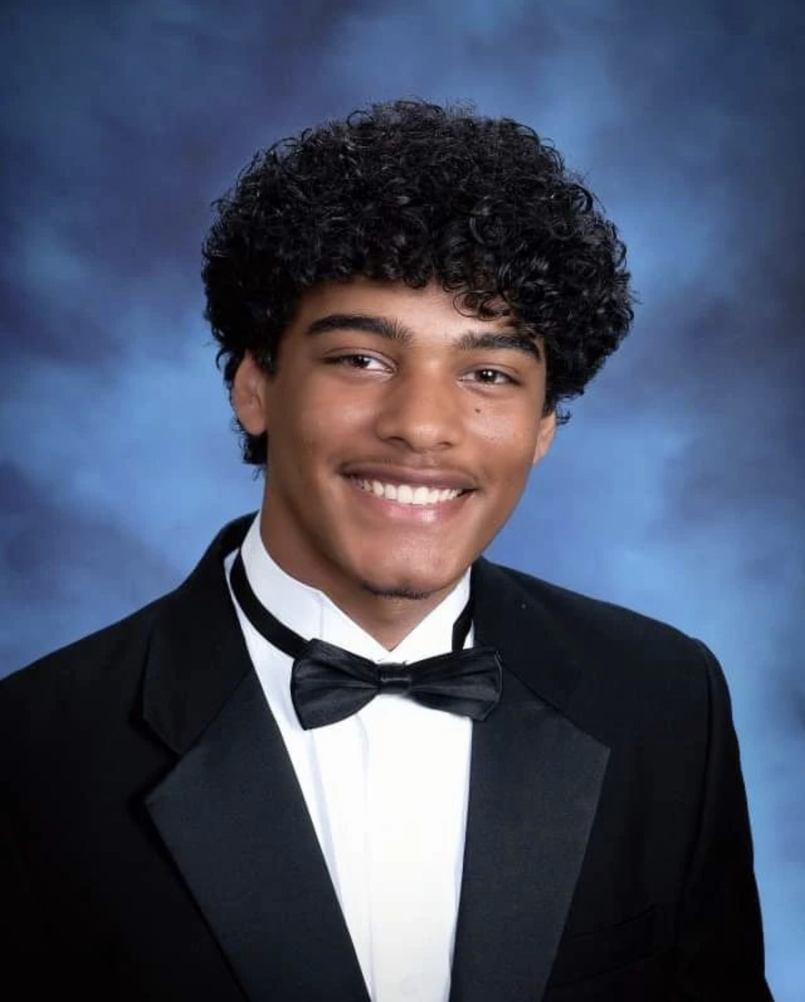
Ronald J. Bryant (RJ)
Is a 2022 graduate of Mercyhurst Prep High School and will be attending the University of Pittsburgh majoring in Nursing this fall. RJ participated on the MPS Basketball team, he is a member of the National Honor Society, Mercy Service Group, the Chess Club and Performing Arts. He has completed over (100) hours of community service, volunteering with Serve Erie, Second Harvest Food Bank, and the Upper Room. RJ wants to earn a master's degree in order to become a Certified Registered Nurse Anesthetist (CRNA). Ronald has a GPA of 4.3413.

Slide 36
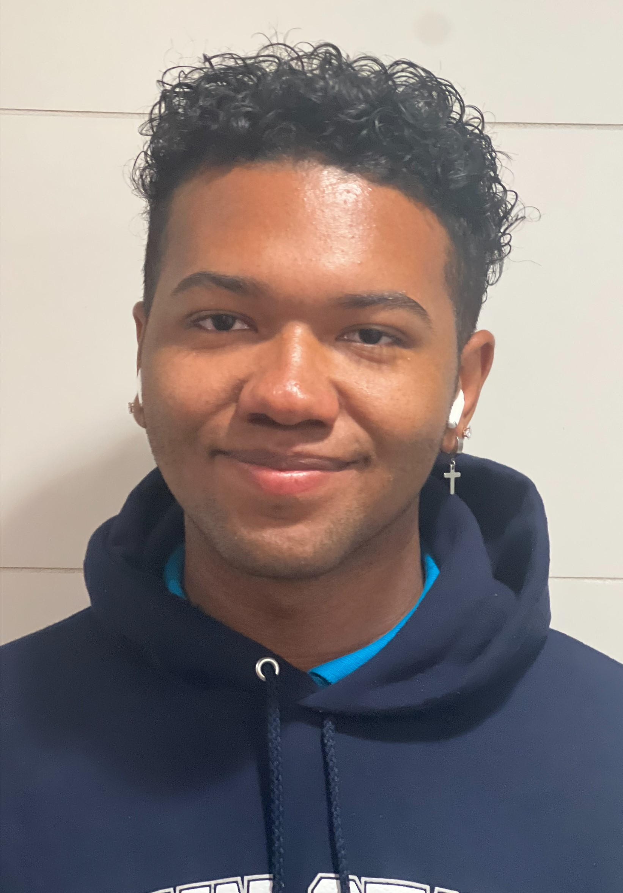
Elijah Japree Dixon
Is the son of Aimel Rodgers. Elijah is a 2022 graduate of Erie High School who be attending Penn State University this fall majoring in Nursing. Elijah participated in the physical therapy and sports medicine CTE class, Go College, Skills USA and Health Scholars. His plan is to complete the BSN undergraduate degree, pursue his master's degree to become a certified nurse practitioner and open a primary care clinic in Erie with his mom, older brother and aunt. Elijah is dependable, hardworking, well rounded, a multi-tasker that always shows initiative in serving others. He has volunteered at SERVE Erie, Emmaus Soup Kitchen and Saint Mary's Home of Erie in addition to working at McDonald's and Party City. Elijah has a GPA of 2.85.

Slide 37
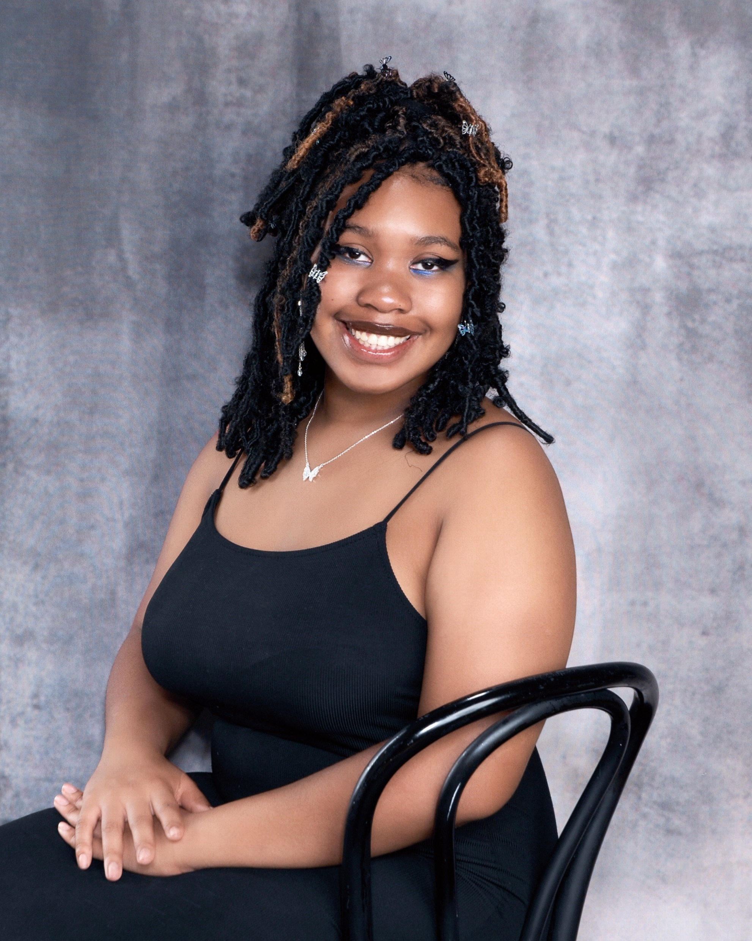
Brooklynn Gore
Is the daughter of Carol Anne Gore and George Gore Jr. Brooklyn and is a 2022 graduate of Northwest Pennsylvania Collegiate Academy. She will be attending the University of Pittsburgh majoring in Forensic Science this fall. Brooklynn is a member of the Green Team, Battle of the Books, Art Club and GSA. She works in the NWPA Art Gallery and Coffee Shop and participates in art contests and theater productions as well as makes her own clothing. Brooklynn is driven, talented, inspired and a focused young woman who appreciates the opportunity to further her career and goals. Creating jewelry is a one of her hobbies, drawing and making jewelry is therapeutic and this hobby developed more during the COVID-19 quarantine. Brooklyn has a 4.18 GPA.

Slide 38
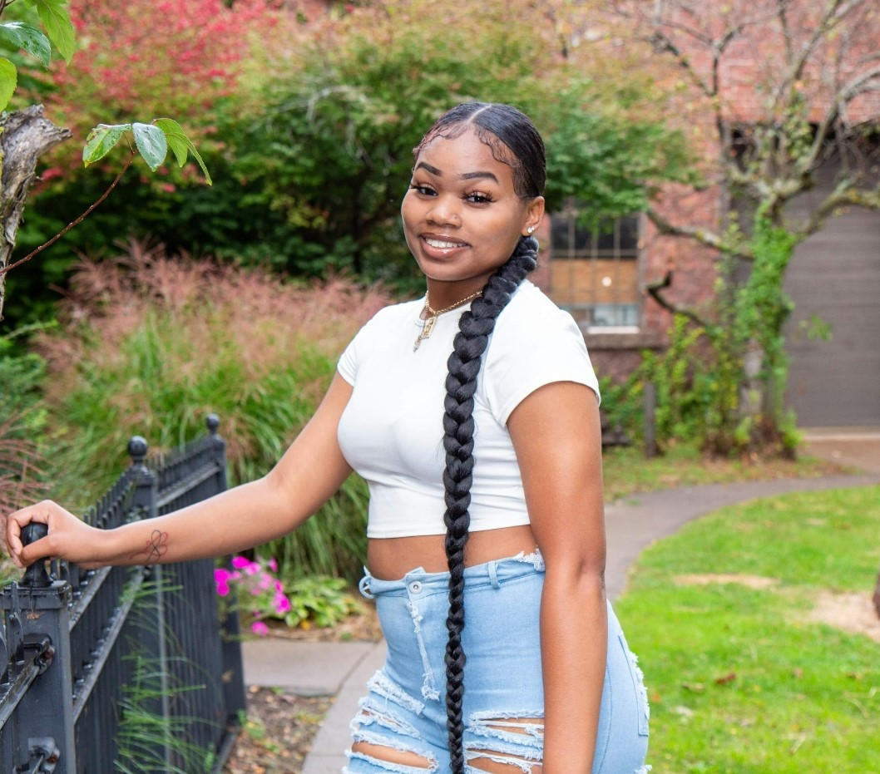
Dezire Tomirah Howard
Is the daughter Theresa Jones. Dezire is a 2022 graduate of the Northwest Pennsylvania Collegiate Academy who will be attending Hampton University in the fall majoring in business administration and marketing. Dezire is a dancer, this passion starting at age 4. She has done many in and out of school performances. She is part of the theater production and helped with multiple plays with work behind the scenes. Dezire is also a member of the Choir, and the Black History Month Committee. She participated in the Street Dance, giving free school supplies to kids of all ages. Through her church she mimes at church services and home-going celebrations. She also had a job working at KFC. Dezire has a GPA of 3.52

Slide 39
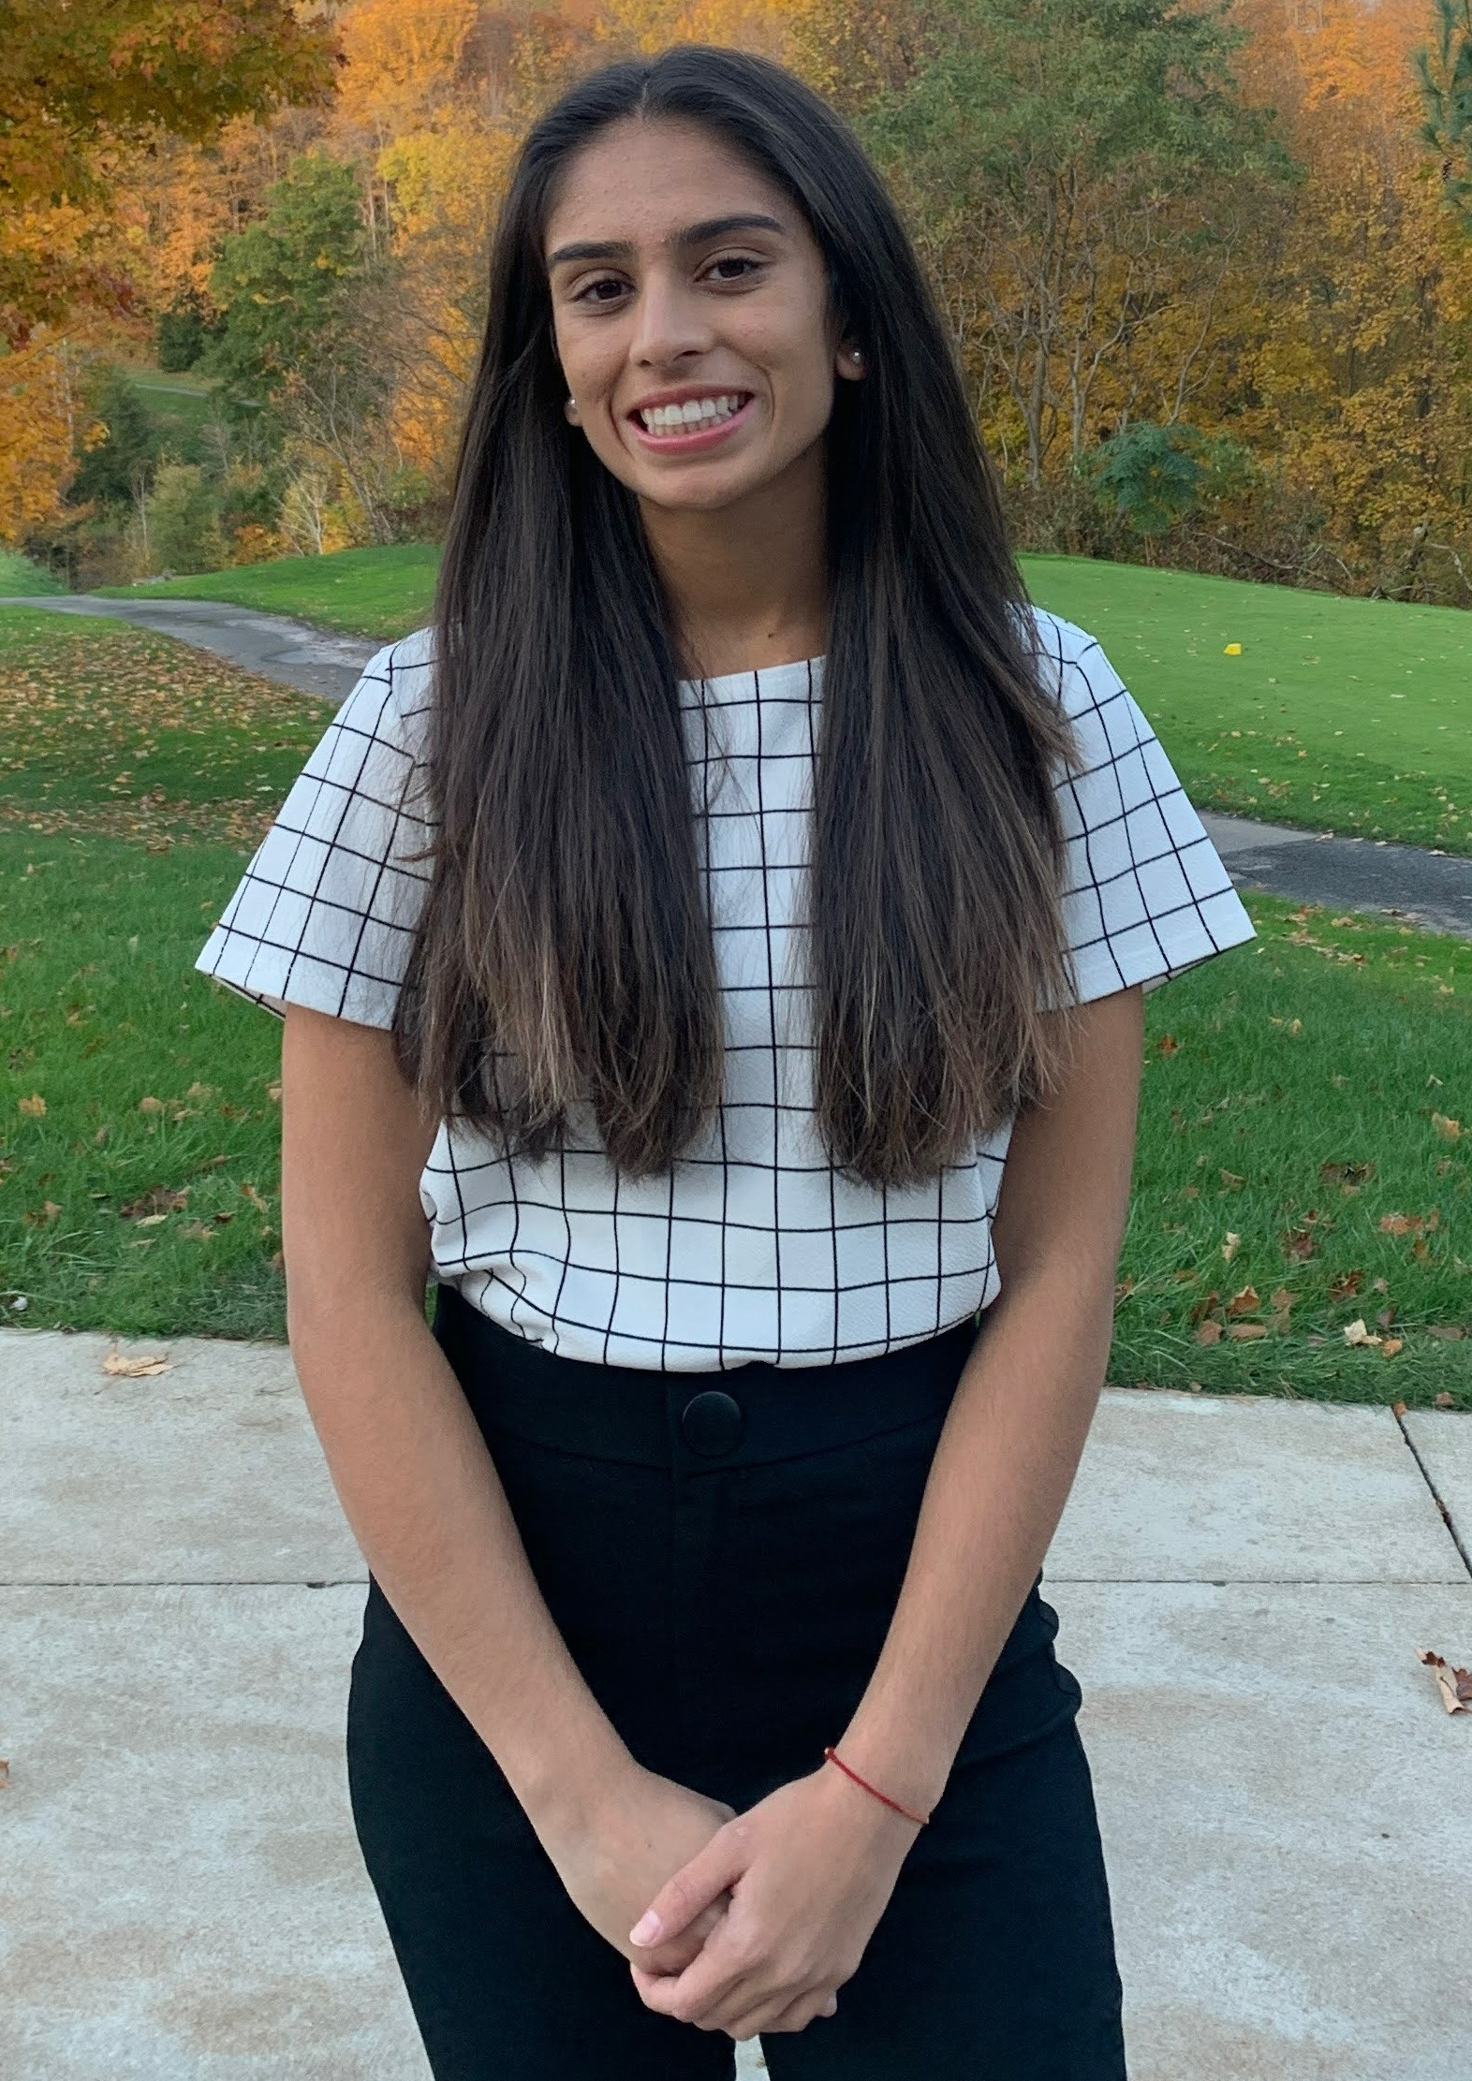
Tia Jain
Is the daughter of Nirmala and Pavan Jain. Tia is a 2022 graduate of Northwest Pennsylvania Collegiate Academy who will be attending the University of Pittsburgh this fall majoring in Biology or Pre-Med. Tia was member of the McDowell High School Girls Varsity Tennis Team, holds a black belt in Tae Kwon Do, President of the Model United Nations, Co-founder of the Medical Club, Co-Director of Expansion, and the Bit Coding Academy. She has volunteered with the American Red Cross, Asbury Woods Nature Center and as a Peer Tutor for the National Honors Society. Her work experiences include Tutoring at Youth Leadership Institute of Erie and an employee at Romolo's Chocolates. Tia is ranked 6th in her graduating class with a GPA of 4.79

Slide 40
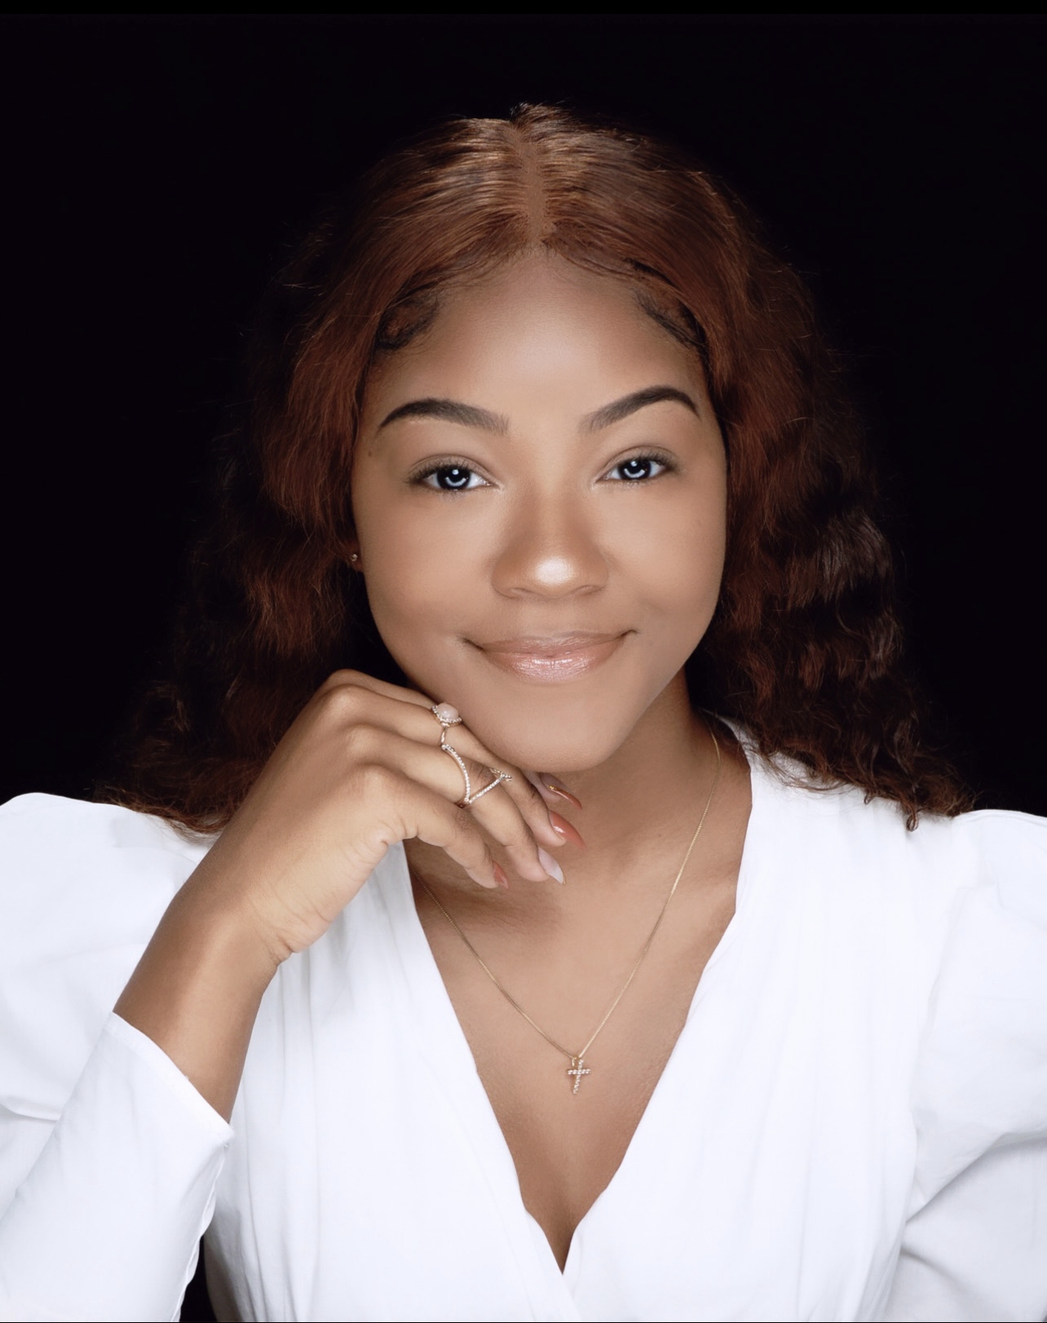
Jasmine Kilana Jones
Is the daughter of Tina and Jermaine Jones. Jasmine is a 2022 graduate of Northwest Pennsylvania Collegiate Academy and will be attending Wayne State University in the fall majoring in Nursing. She is honest, trustworthy, innovative and passionate about everything that she does. She volunteers at a local youth organization, conducted a food drive through her church Youth Department. She has assisted with youth basketball games and has held multiple jobs including a cashier at Once Upon A Child, a crew member with McDonald's and Room Service at St. Vincent Hospital. Her goal is to become a nurse, and later become a doctor and own her own hospital that will open opportunities for other African American females in healthcare. Jasmine has a GPA of 3.66.

Slide 41

Pasya Kashindi
Is the son of Nyta Amisi. Pasya and a 2022 graduate of Northwest Pennsylvania Collegiate Academy and will be attending Howard University in the fall majoring in Biology. Paysa has a unique story, his family escaped from a war-torn Congo to Malawi and eventually to the United States. His comments are, he would like to imagine the American Dream is a little boy named Pasya Kashindi, a little boy who escaped war, who was raised in a household of eleven by a single mother and a grandmother with cancer. He is described as a young man driven to inspire positive social change in the school and in the community. He was the captain of the varsity wrestling team, started his own podcast, and is in the process of writing his own novel. Pasya created a club to help fellow students achieve their health goals. He is a squad leader for the JROTC, is a member of the Art and Archery clubs, and helped raise over $ 20,000.00 to help pay for his best friend' s funeral costs. Pasya has a GPA of 4.45.

Slide 42
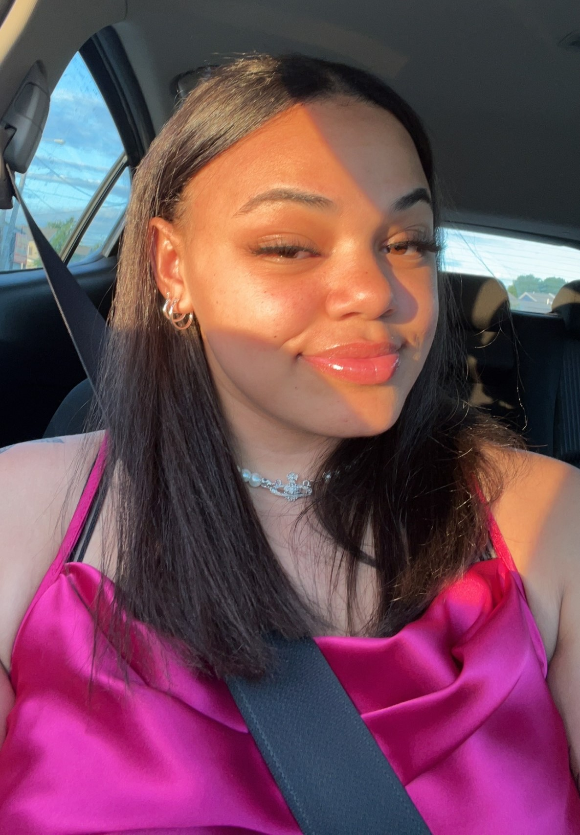
Arianna Leeann Mitchell
Is the daughter of Kristie Barnes and Eric Mitchell. Arianna is a 2022 graduate of Northwest Pennsylvania Collegiate Academy and will be attending Slippery Rock University in the fall majoring in Criminal Justice or Cyber Security. She is described as one who leads by example whether it was small group discussions, community outings, providing community service, and as a leader of her basketball clubs. She maintained rigorous course work while playing basketball for Erie High while working part-time. Overcoming obstacles of racism, racial remarks because of her race has helped to strengthen her character. All the things she has endured during he nine years of organized basketball have shaped her into the person she has become, and she is proud of her African American heritage. Arianna has a 3.0 GPA.

Slide 43
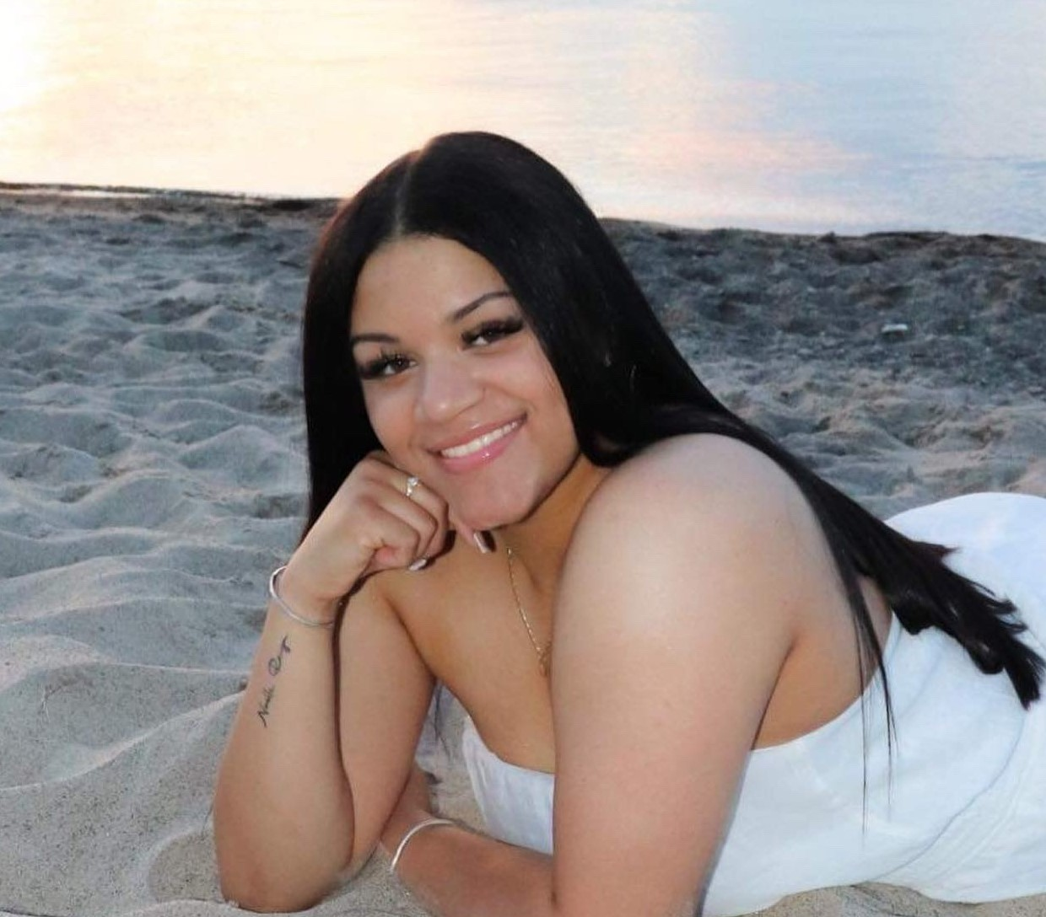
Sydnee Jean Molder-Kinnard
Is the daughter of Mary Molder. Sydnee is a 2022 graduate of Northwest PA Collegiate Academy and will be attending Gannon University majoring in Nursing this fall. She played volleyball and softball during her freshman year and was a cheerleader her sophomore year. Sydnee held jobs all 4 years of her high school career. She has worked at Sonic Drive-In, Walmart, and Romolo’s Chocolates. She is a well-rounded person, someone who is very respectful and courteous, and well liked and respected by the faculty and students. As a teen mother she has juggled college courses, high school and job. She is considered a team player and put outs everything she has in completing the goals she sets for herself. Sydnee aspires to be a role model for others and an example of what can come from hard work and dedication. As a mother, she intends to act as her daughter's guide to success. Sydnee has a GPA of 3.8

Slide 44
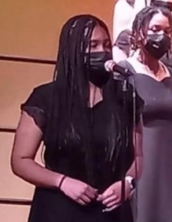
Khadijah E. Nickson
Is the daughter of Tica and Ken Nickson Jr. Khadijah is a 2022 graduate of the Northwest Pennsylvania Collegiate Academy and will be attending Penn State Behrend this fall with an undecided major. Khadijah participated in sports her entire high school career, including basketball, volleyball and softball. She is a member of two of Collegiate Academy’s Vocal Ensembles. She is described as confident, kind, thoughtful, and intelligent young lady that understands the importance of working hard. Her career goal is to become a nurse and go on to Medical School to become an anesthesiologist. Khadijah has a 3.21 GPA.

Slide 45
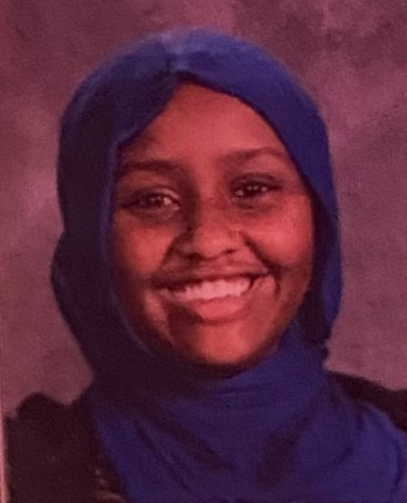
Nasro Mohamed Noor
Is the daughter of Futuma Jama and Asha Noor. Nasro is a 2022 graduate of Northwest Pennsylvania Collegiate Academy who will be attending Indiana University of Pennsylvania majoring in Nursing this fall. She is described as a self-starter, an all-around excellent student that does not need to be reminded of expectations or when to submit assignments. She is quick to lend a helping hand and exemplifies the Collegiate Academy Motto, “always reaching higher.” Nasro participated in the Medical Club, is a member of the National Honor Society. Her community service includes cleaning at the Islamic Association of Erie, teaching Bit Coding to elementary kids, and volunteers at the Quality of Life Learning Center. She has held employment positions at Little Caesars, Burger King, and babysitting. Nasro has a GPA of 4.09.

Slide 46
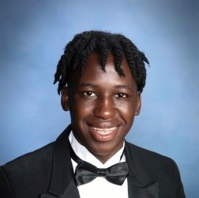
Henry Edward Olango
Is the son of Edward Olango and Victoria Angello. Henry is a 2022 graduate of Northwest Pennsylvania Collegiate Academy High School who will be attending Howard University or Morehouse College this fall majoring in Biology or Electrical Engineering. Henry participated on the Varsity Soccer and Wrestling teams, and a member of the NWPCA Body Improvement Club. He performed volunteer service through the Urban Erie Community Development Corporation, and the JROTC. He has been employed with McDonald's and Taco Bell. Overcoming civil war in his native country (South Sudan) that forced his parents to immigrate to the United States. He is a passionate, hardworking, mature, well balanced and driven. He excels in the classroom, balances his extra curricular activities, work schedule and volunteering with great composure and poise. Henry has a GPA of 3.53.

Slide 47
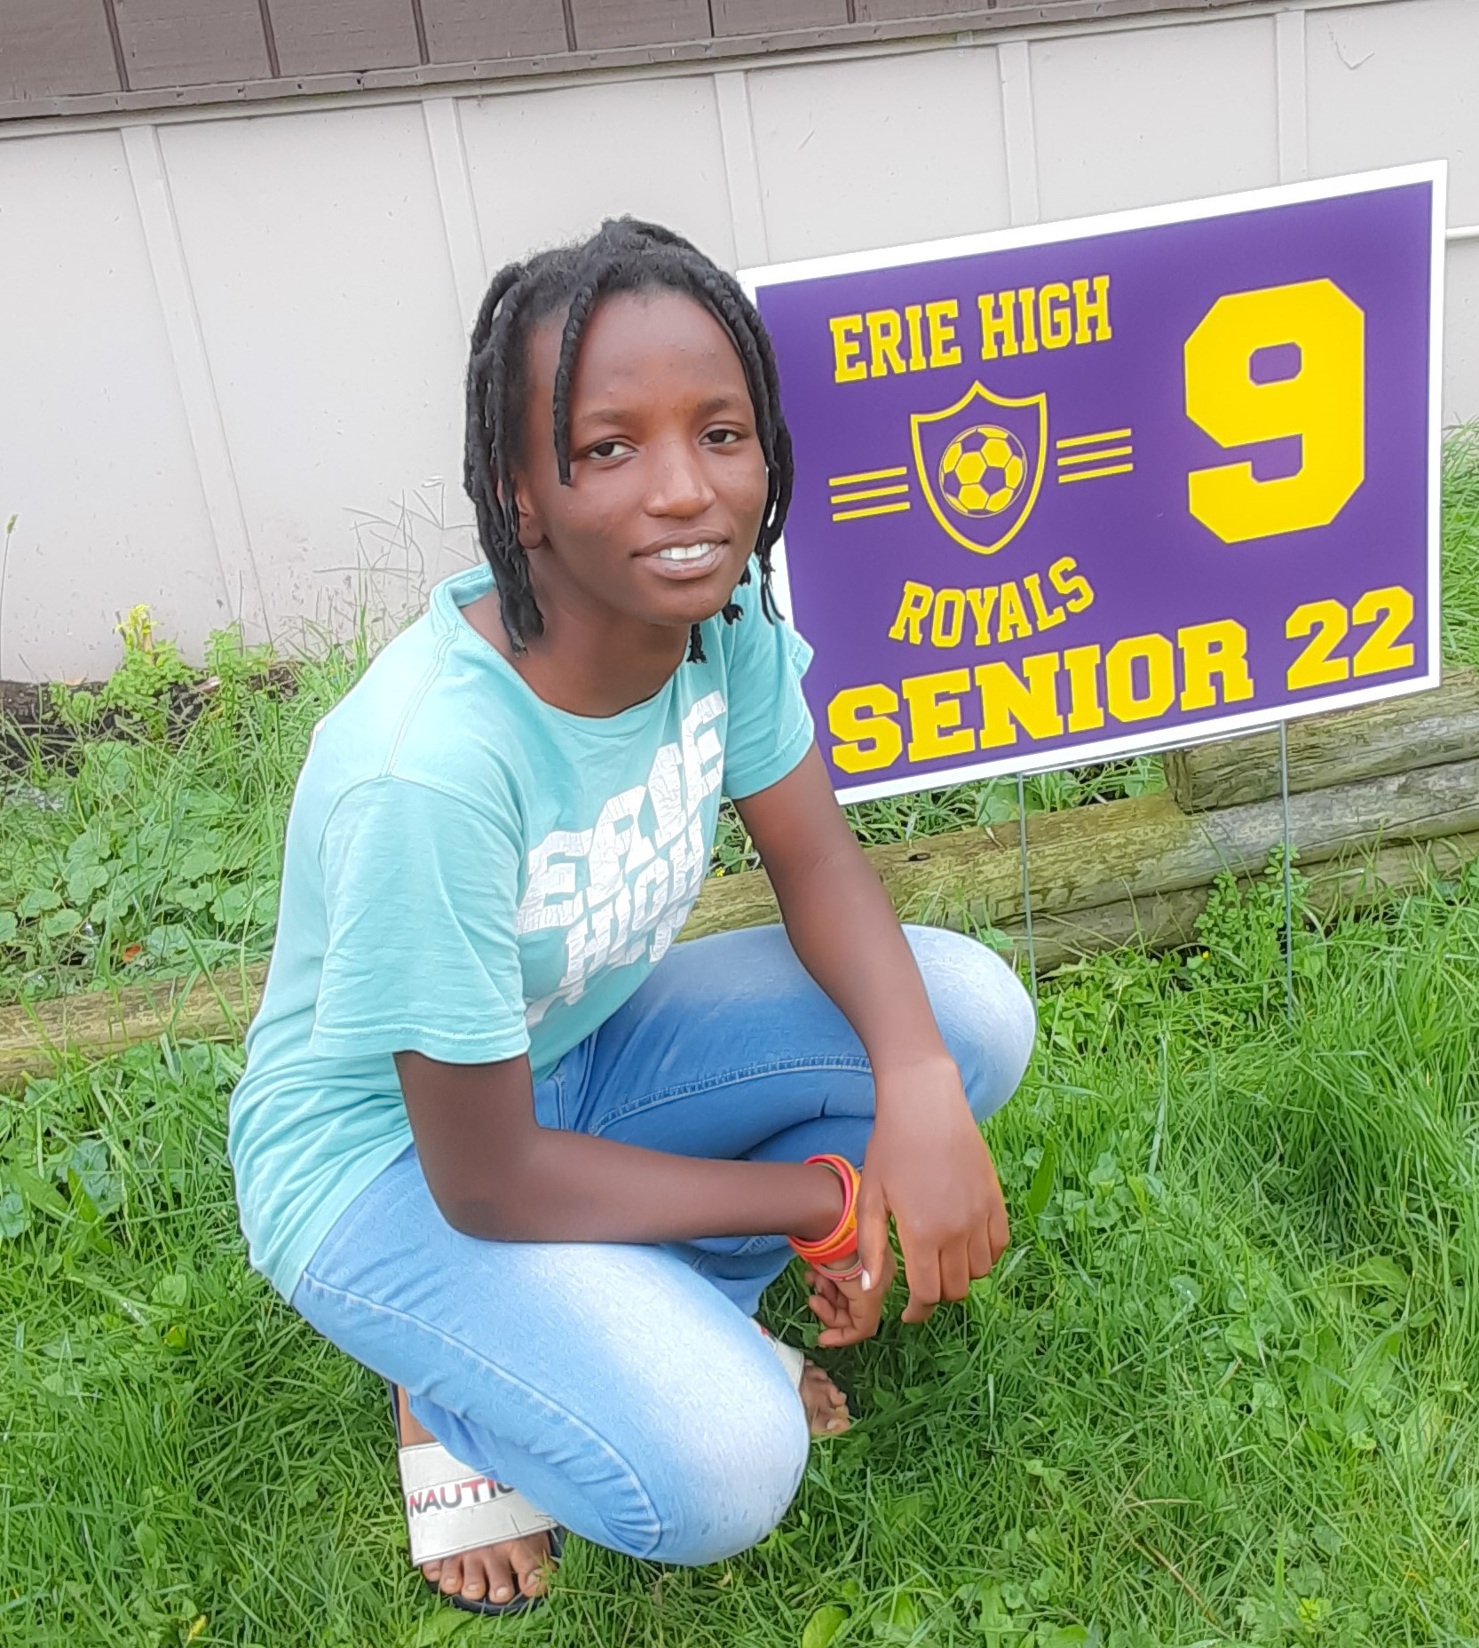
Grace Rukundo
Is the daughter of Dieudonne Arahama and Riziki Bahati. Grace is a 2022 graduate of Erie High School who will be attending Penn State Behrend in the fall majoring in Nursing. Grace is a native of Burundi, she started her education here in America in 6th grade. Grace participated in the National Honor Society, National Technical Honor Society and Go College. Her career goal is to be a RN to help others with her medical knowledge to promote health in the community. Her favorite sport is soccer and playing soccer gave her discipline and taught the skills needed to work as a team. She plans to play soccer in college. Grace has a GPA of 3.8.

Slide 48
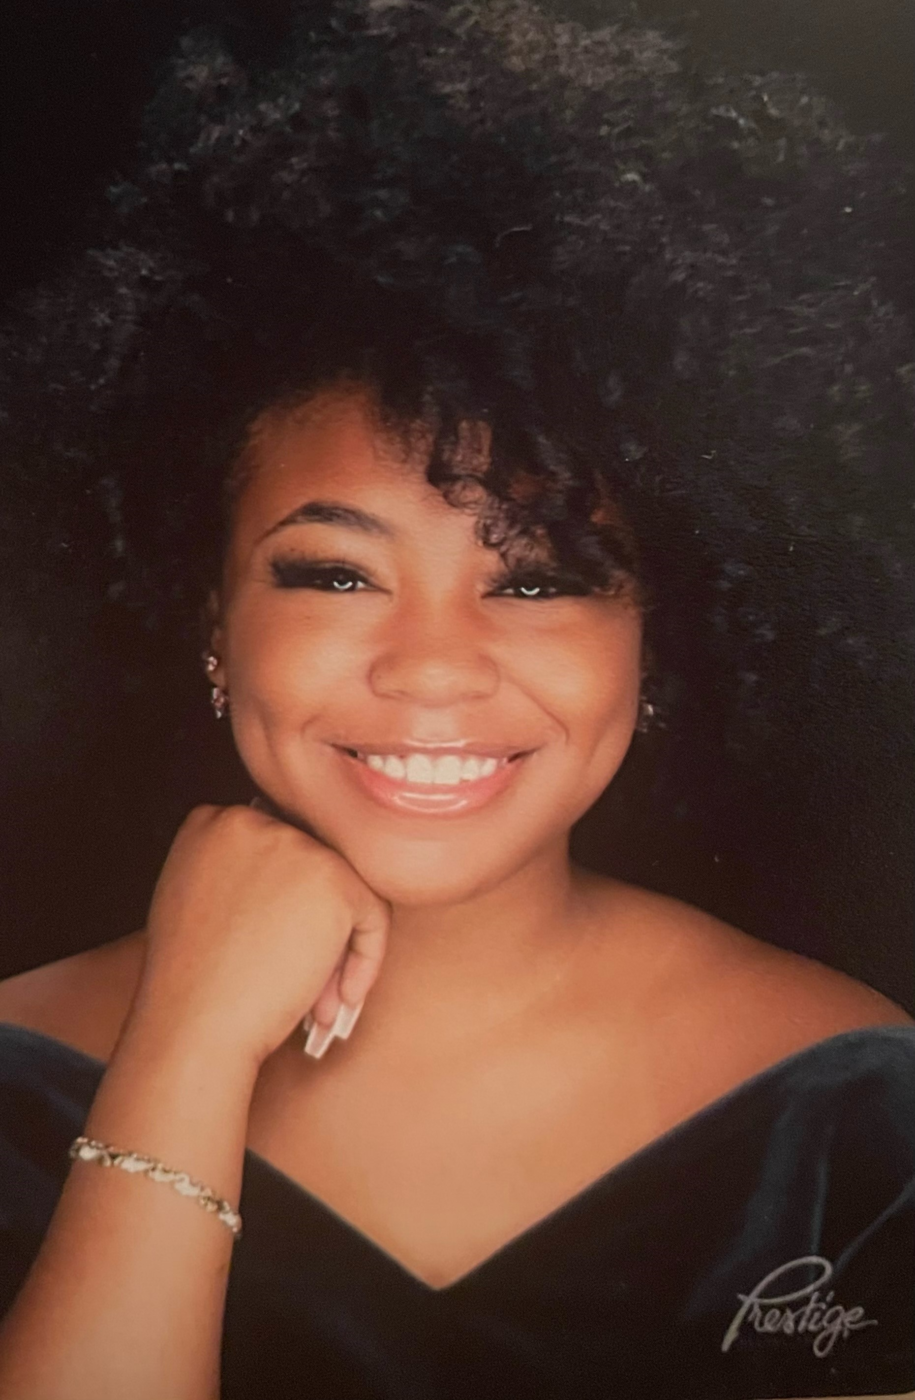
Jordan Iyanna Smith
Is the daughter of Kishana Johnson and Christopher Smith. Jordan is a 2022 graduate of Northwest Pennsylvania Collegiate Academy who will be attending Clark Atlanta University with an undecided major this fall. Jordan has participated in the Collegiate Dance Program, Little's Dance Studio Senior Performance Dance Team, the Black History Assembly Coordinator, Erie Playhouse Performing Arts, and the School Book Club. She has done volunteer work with Little's Dance Studio as a Classroom Assistant, The Learning Ladder School Age Dance Mentor, The Gallery at Collegiate Academy. She currently is working as a food server at Pineapple's Southern Bistro. Jordan is described has a strong work ethic, with attention to detail and a strong sense of self. Her willingness to adapt, and her maturity and positivity has made her a role model for both her younger and older peers. Jordan has a GPA of 3.55

Slide 49
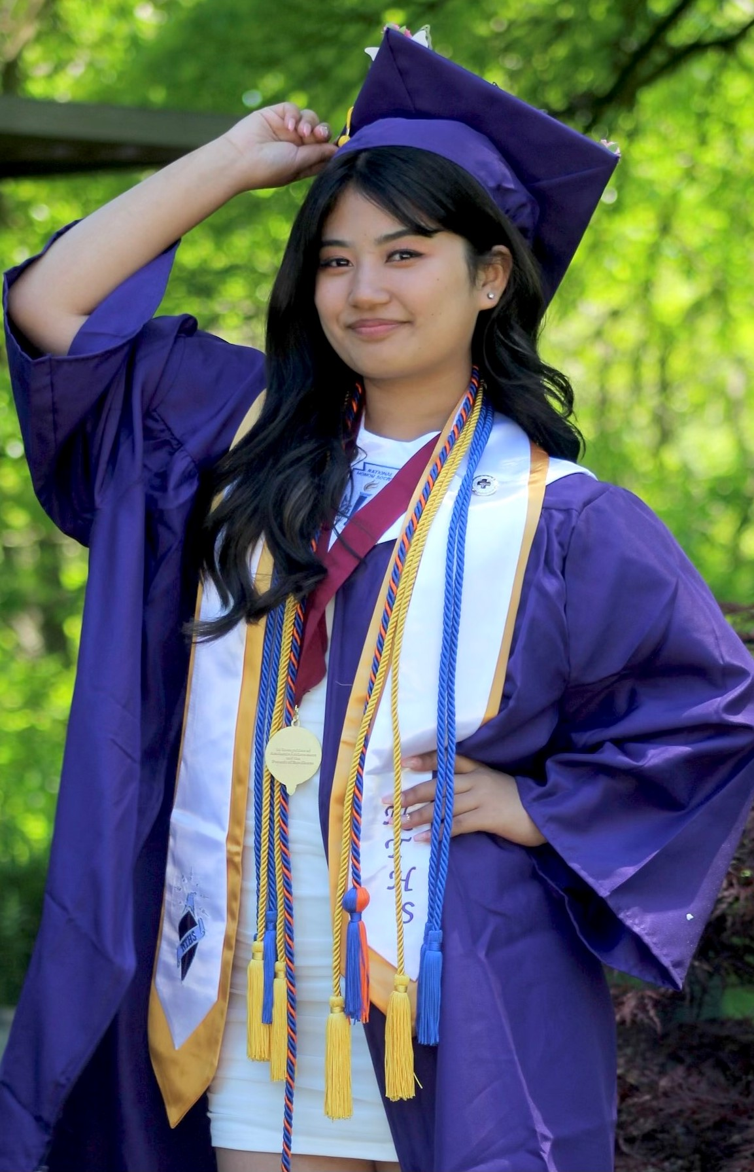
Anjana Tamang
Is the daughter of Pasang Tamang and Suk Tamang. Anjana is a 2022 graduate of Erie High School and will be attending Penn State Behrend majoring in Nursing this fall. Anjana came to America at the age of six from Nepal. She has often received discriminatory treatment because of her Asian features. Anjana states she takes all these negative episodes in her life and builds herself to become a stronger and hardworking person. She has learned to embrace and appreciate her culture and diverse background. Her goal is to become a registered Nurse. She would like to contribute to her community by promoting healthy lifestyles, healing patients and offering emotional support to them. She is described as having a diligent work ethic, a passion for reading and outstanding time management skills. She is able to work independently, as well as with others. She participates in the Go College Program, National Honor Society, UPMC Health Scholars Program, the National Technical Society and the National Society of High School Scholars. Anjana is ranked 1st in her graduating class with a GPA of 4.31.

Slide 50
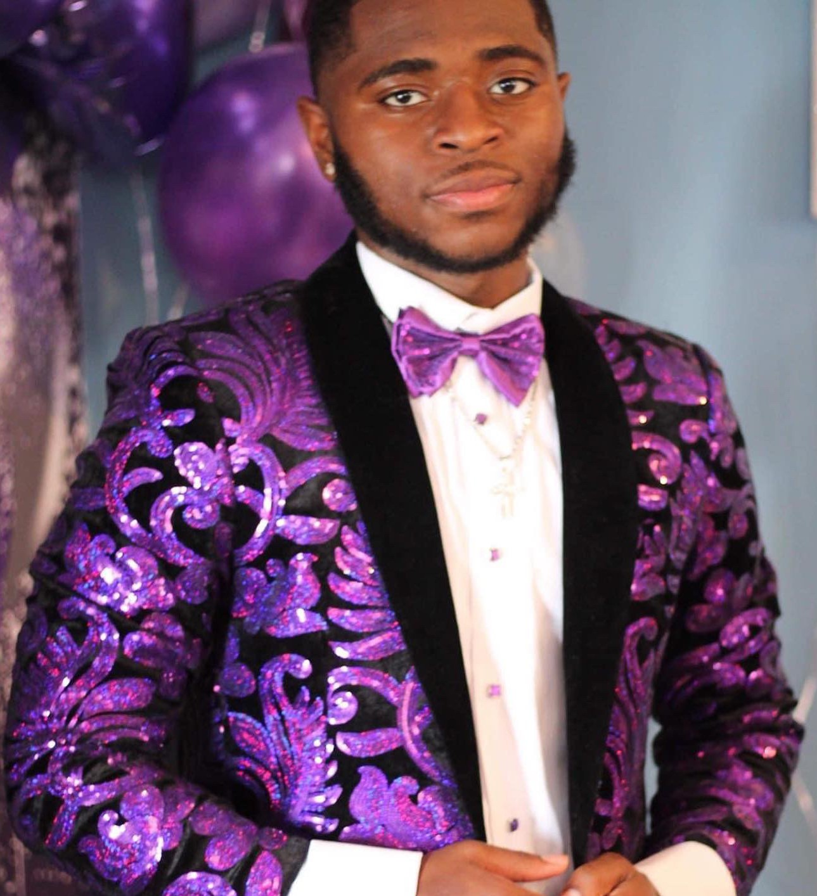
Sayvion Sharif Willis
Is the son of Angelique Parker and Gyasi Stewart. Sayvion is a 2022 graduate of Northwest PA Collegiate Academy who will be attending Saint Vincent College this fall as a Physical Therapy major. Sayvion, is of African American and Trinidadian heritage. He was a member of the Varsity football team, volunteered with Sisters of St. Joseph and held employment positions at KFC, Chick-Fil-A, and Sisters of Saint Joseph Neighborhood Network. He wants to obtain a minor in Sports Management to become a Physical Therapist/Athletic Trainer. Sayvion is described as a natural leader with exceptional work habits, dependable, trustworthy, reliable and a role model for his fellow peers. Recognized by his employer as a Star of the Month on several occasions, he helped ensure the success of their Annual Day of Giving, in which their company cooks and donate hot meals to the various homeless and women shelters in Erie. Once he has achieved his educational goals, he plans to educate and return home to help kids understand their body’s functions and take every opportunity to become successful and able to take care of their families. Sayvion has a 3:27 GPA.

Slide 52
Omega Scholarship Recipients
Sponsored by Zeta Pi Chapter
Zeta Pi Founder’s Scholarship Henry Edward Olango
Bobby Kaigler Memorial Scholarship Sayvion S. Willis
Junius/Chevalier Johnson Family Scholarship Nabia Attique
Thomas/Annie Myers Sr. Memorial Scholarship Dezire T. Howard
Dr. Vernon/Mary L. Dobbs Family Scholarship Paysa Kashindi
Johnny Johnson Family Vision Scholarship [Paysa Kashindi]
[Shaan W. Bolden]
[Grace Rukundo]
Smith Family Scholarship Jordan I. Smith
Sydnee Jean Molder-Kinnard
Robert M. Barney Memorial Scholarship Aronde M. Bridgett
Uplift Foundation Trey J. Battle
Uplift Foundation Khadijah E. Nickson
Uplift Foundation Brooklyn Gore
Uplift Foundation Anjana Tamang

Slide 53
My Brother's Keeper Scholarships Recipients
Sponsored by Community Partners
Mr. & Mrs. Howard R. & Mildred Smith Horton Memorial Scholarship {Jordan I. Smith} {Henry Edward Olango {Nasro M. Noor}
Eva Tucker Jr. Memorial Scholarship {Nabia Attique}
{Tia Jian} Jones Family Scholarship {Jasmine K. Jones}
{Arianna L. Mitchell}
Rev. Jon S. & Mrs. Rafalda Goshay Scholarship {Henry Edward Olango}
{Nabia Attique}
Kathy M. Goshay Memorial Scholarship Nasro M. Noor
Mitchell Jones Jr. Memorial Scholarship {Jasmine K. Jones}
{Arianna Mitchell}
Erie Rise Leadership Academy Alumni Scholarship Aronde M. Bridgett
Leach-Ruff Family Scholarship Jordan I. Smith
Eric Kenneth Clayton Memorial Scholarship (EKCMS) Henry Edward Olango
Super Soul Saturday Program Memorial Scholarship Ronald J. Bryant
McConnell Family Scholarship Samantha E. Baker

Slide 54
My Brother's Keeper Scholarships Recipients
Sponsored by Community Partners
A.J. Smitherman “Black Wall Street Commitment to Excellence Award” Trey J. Battle
James Family Scholarship {Nabia Attique}
{Khadijah E. Nickson}
Giving Tree Scholarship {Tia Jain}
{Brooklyn Gore}

Slide 55
Bridge Builder Scholarships Recipients
Provided through a grant from the Greater Erie Economic Development Corporation (GEEDC)
John M. Drew Bridge Builder Scholarship Elijah J. Dixon
Johnny Harris Bridge Builder Scholarship {Paysa Kashindi}
Ronald A. Steele Bridge Builder Scholarship Gabriel R. Alexander
R. Benjamin Wiley Bridge Builder Scholarship Ronald J. Bryant
Bridge Builder Scholarship Jasmine K. Jones
Bridge Builder Scholarship {Arianna L. Mitchell}

Slide 57
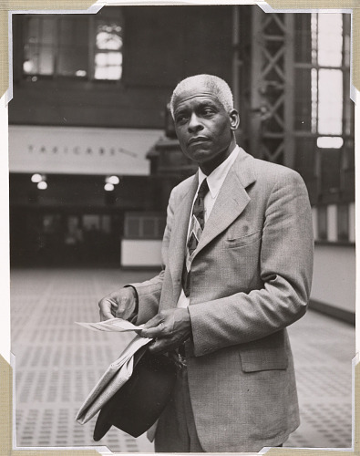
“I only have just a minute. Only sixty seconds in it. Forced upon me, can’t refuse it. Didn’t seek it, didn’t choose it. But it’s up to me to use it. I must suffer if I lose it. Give account if I abuse it. Just a tiny little minute but eternity is in it”.
Dr. Benjamin E. Mays, (Deceased)
President Emeritus of Morehouse College
Member Omega Psi Phi Fraternity

Slide 58
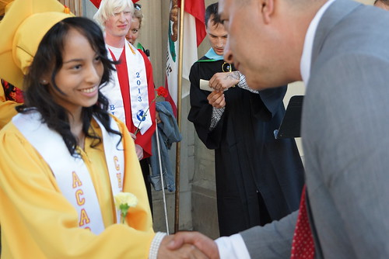
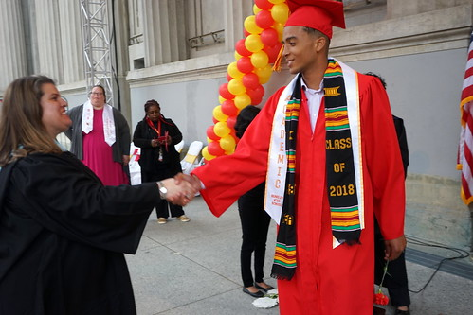


Shaping the Future
“Class of 2022”
CONGRATULATIONS!!!!

